Slide 1








SPICA the new 6T visible combiner for the CHARA Array
D. Mourard (PI), A. Meilland, P. Berio, J. Dejonghe, D. Lecron,
F. Morand, D. Salabert, F. Allouche, N. Anugu, S. Bosio,
L. Bourges, O. Creevey, S. Deheuvels, A. Domiciano de Souza,
N. Ebrahimkutty, D. Gies, R. Ibanez Bustos, J. Jonak, R. Ligi,
G. Mella, N. Nardetto, K. Perraut, S. Rousseau, M. Vrard,
G. Schaefer, A. Spang, and M. Wittkowski

Slide 2
SPICA in a nutshell
SPICA-VIS 6T-combiner (0.6-0.9μm)
  3 spectral-dispersions
  spatial filtering with monomode fibers
SPICA-FT: H-band 6T- fringe-tracker
  using a ABCD-combiner integrated-optics
  installed on MIRCX (using the detector and replacing the All-in-One combiner)
MODES | Nb of SpCh | SpCh | Spectral Band | MagLim V²=0.6 | MagLim V²=0.6 + FT | MagLim Vdiff | MagLim Vdiff+FT
LR: R=140 | 60 | ~5nm | 300nm | 8.5 | 11.5
MR: R=4400 | 500 | 0.17nm | 85nm |  |  | 5.5 | 9.5
HR: R=13000 | 500 | 0.06nm | 29nm |  |  | 4.5 | 8.5
MagLim: V²: SNR=10, 10mn of integration, for one spectral channel
Vdiff: [SNR=10, σφ<5°], V²=0.6 in the reference channel, 30mn of integration, for one spectral channel
SNR calculator based on FRIEND calibration (Martinod+2018), CHARA-AO hypothesis (SR=20%), Vinstr=0.9

Slide 3
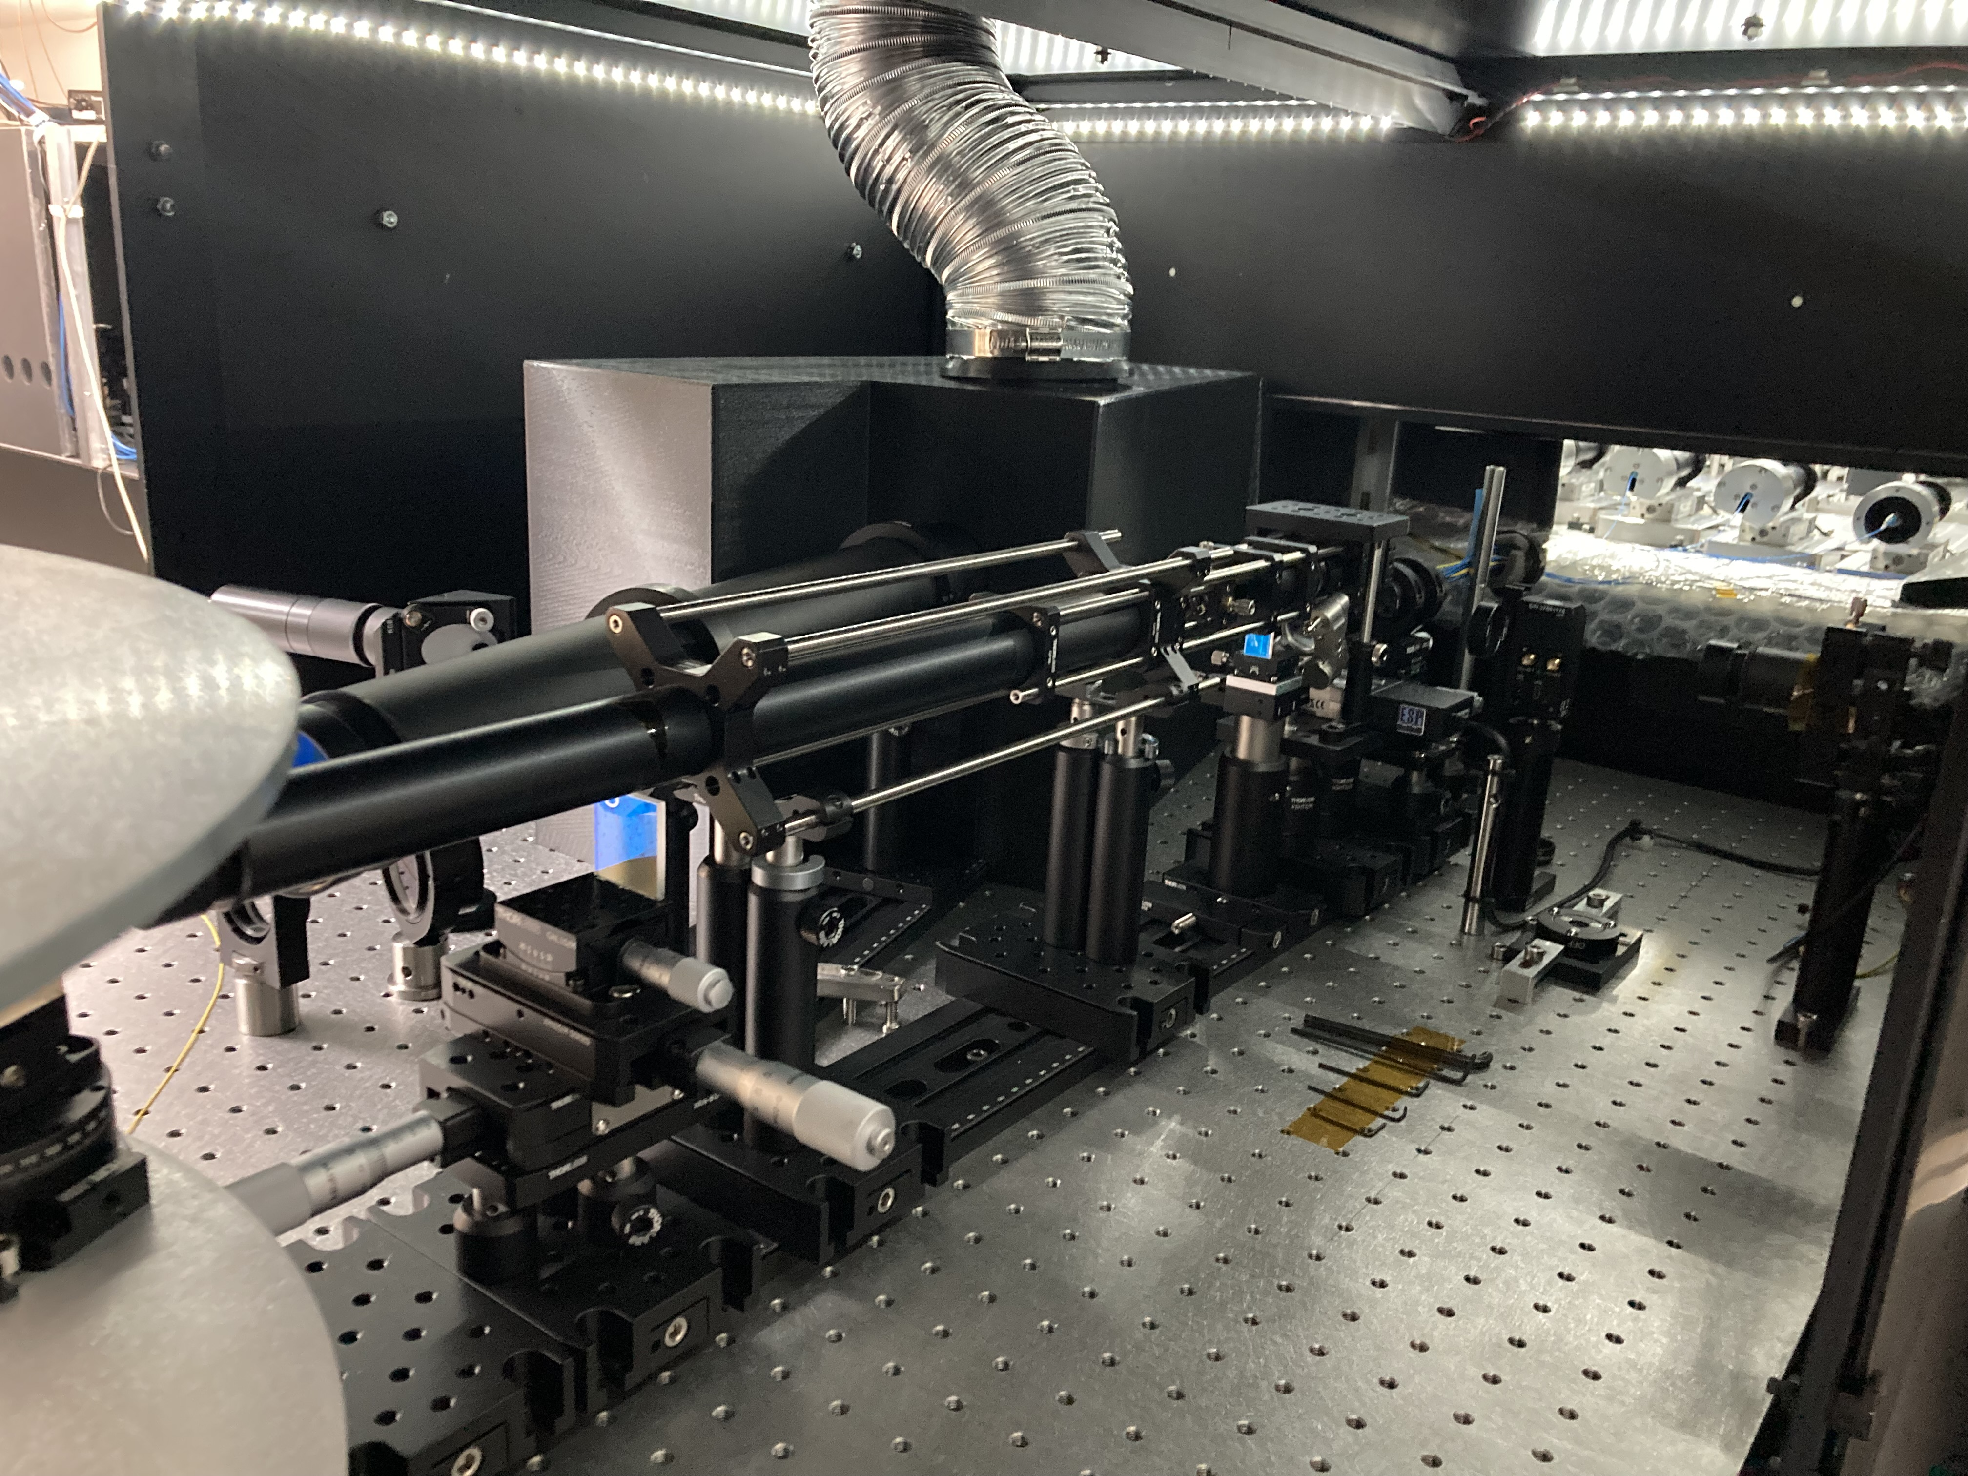
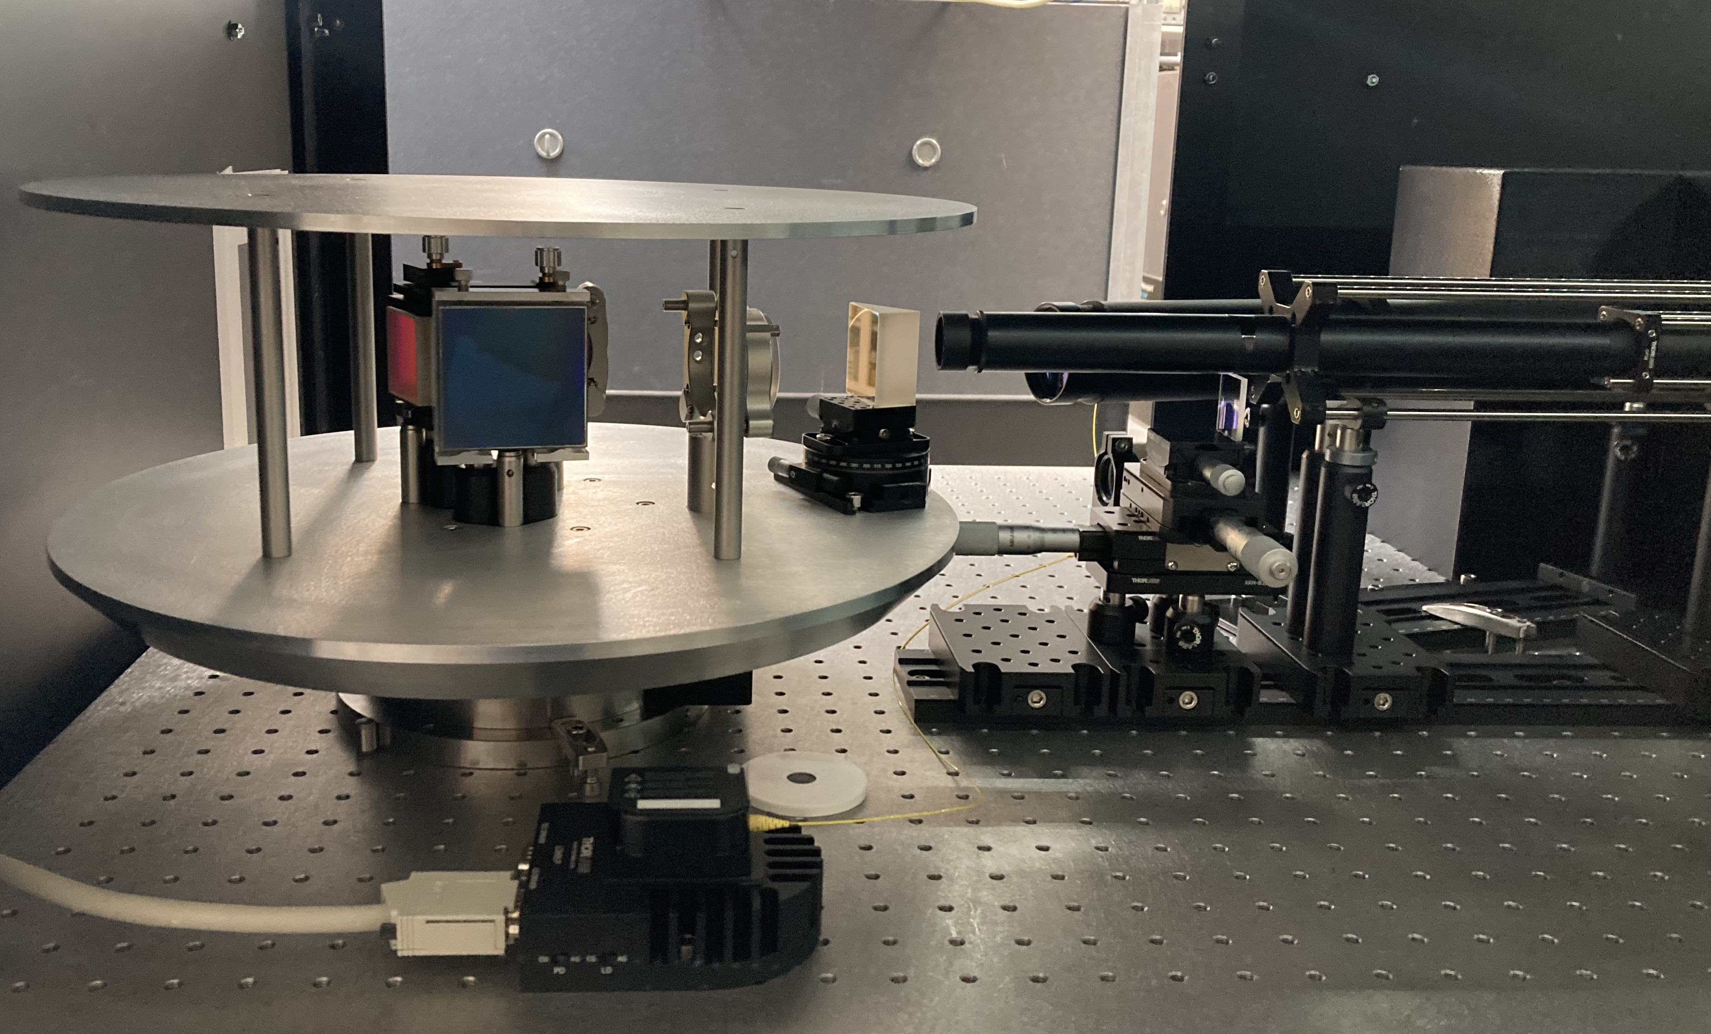
SPICA-VIS installed at Mount Wilson in Feb 2022
Detail of the dispersion unit:
Low Resolution R = 140
Medium Resolution R = 4400
High Resolution R = 13000
Spectrograph Table

Slide 4
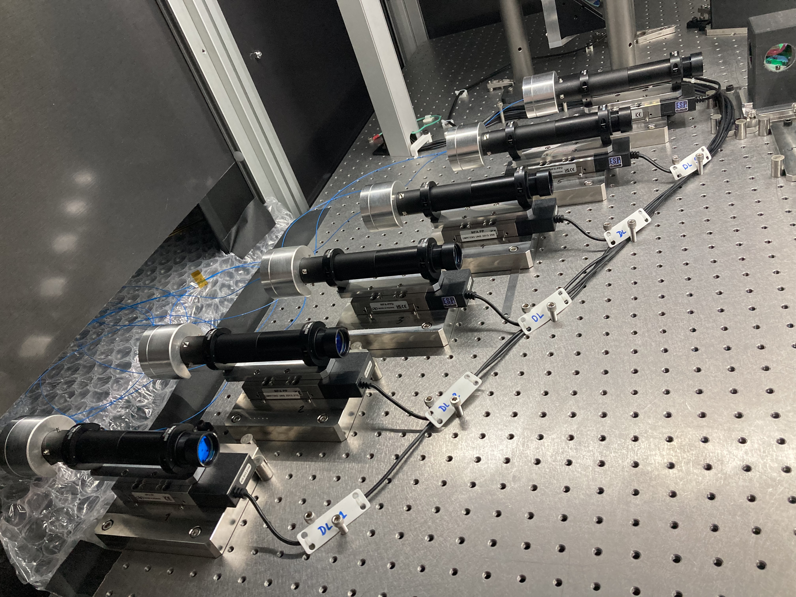
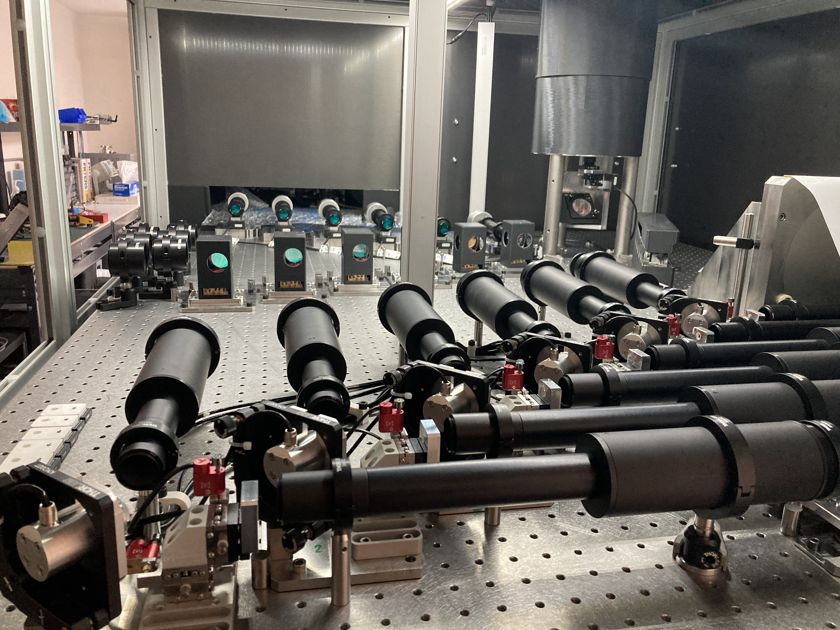
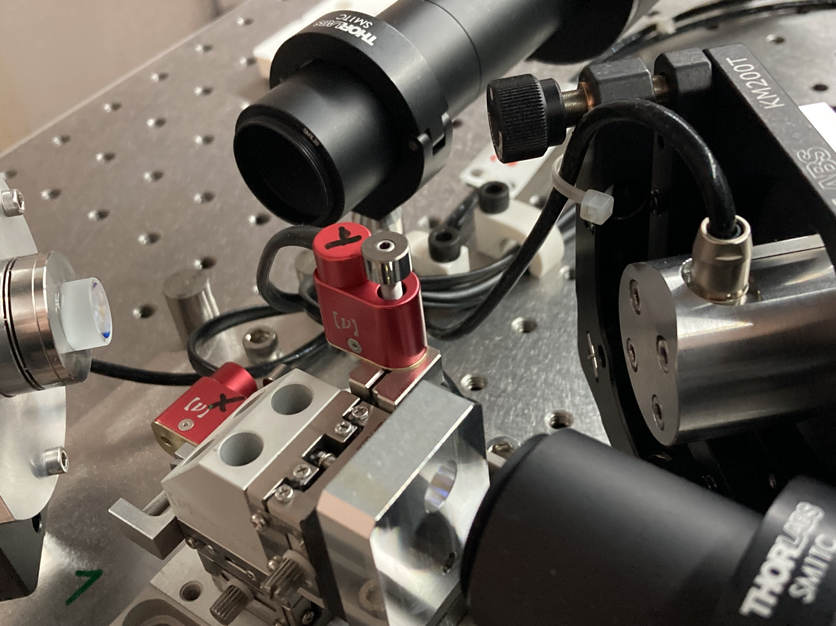
SPICA-VIS installed at Mount Wilson in Feb 2022
Image and Pupil plane control
Injection modules including DDLs
Fast tip/tilt
Pupil Control unit
General view of the injection table
Notes:
J’ai rajouté la mention du fast tip/tilt pour la stabilisation de l’injection mais ça fait pas très beau. A toi de voir
J’ai aussi mis la mention en haut à droite… à voir aussi

Slide 5
SPICA-VIS commissioning in 2023
All 15 fringes simultaneously on SPICA with MIRCx and MYSTIC (June 23)
Implementation of chromatic OPD validated in September 2023
Organisation of night based on ‘survey mode’ ➔ one data point every 30mn
End of night automatic pipeline up to L0 and L1 data (uncalibrated ➔ OiDB)
Calibration pipeline validated (work for SPICA, MIRCx and MYSTIC data)

Slide 6
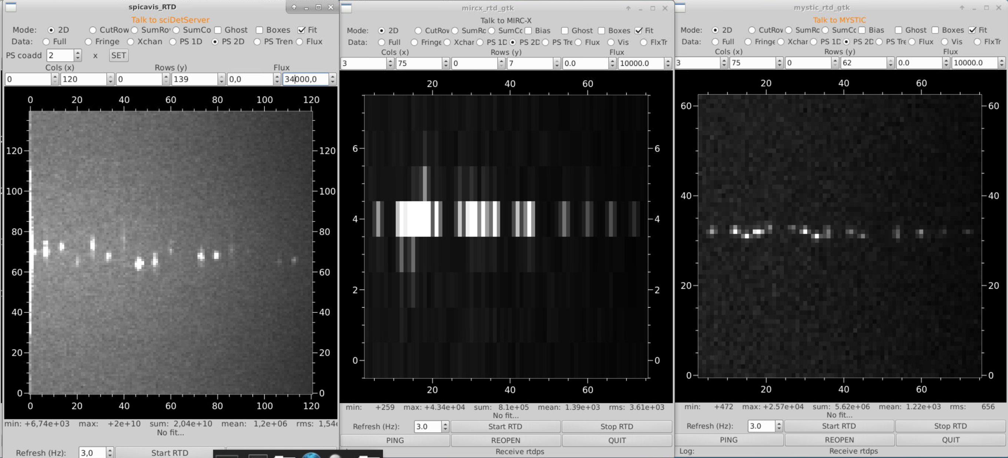
SPICA-VIS commissioning in 2023
All 15 fringes simultaneously on SPICA with MIRCx and MYSTIC (June 23)
2D power-Spectrum on the 3 instruments showing 15 fringe-peaks on a bright calibrator (HD3360)

Slide 7
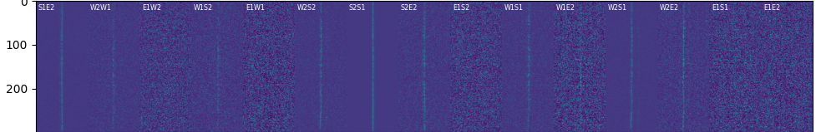
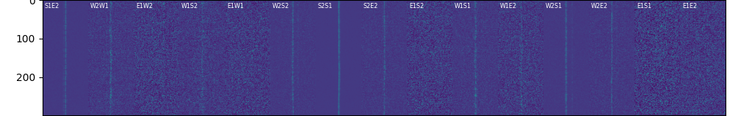
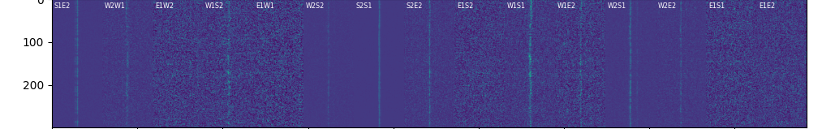
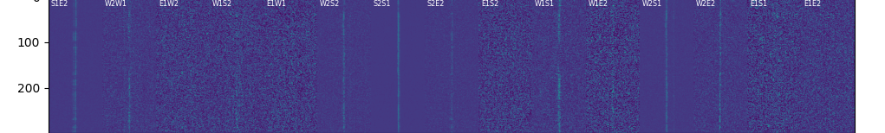
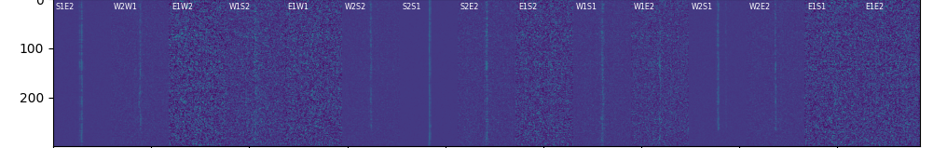
SPICA-VIS commissioning in 2023
All 15 fringes simultaneously on SPICA with MIRCx and MYSTIC (June 23)
Implementation of chromatic OPD validated in September 2023
Correction of the longitudinal dispersion
Common LDC updated every 6s
➔ small OPD offset in the OPLE control
Visible LDC updated every 6s
SPICA internal DDL adjusted simultaneously
waterfall of SPICA fringes over 10min

Slide 8
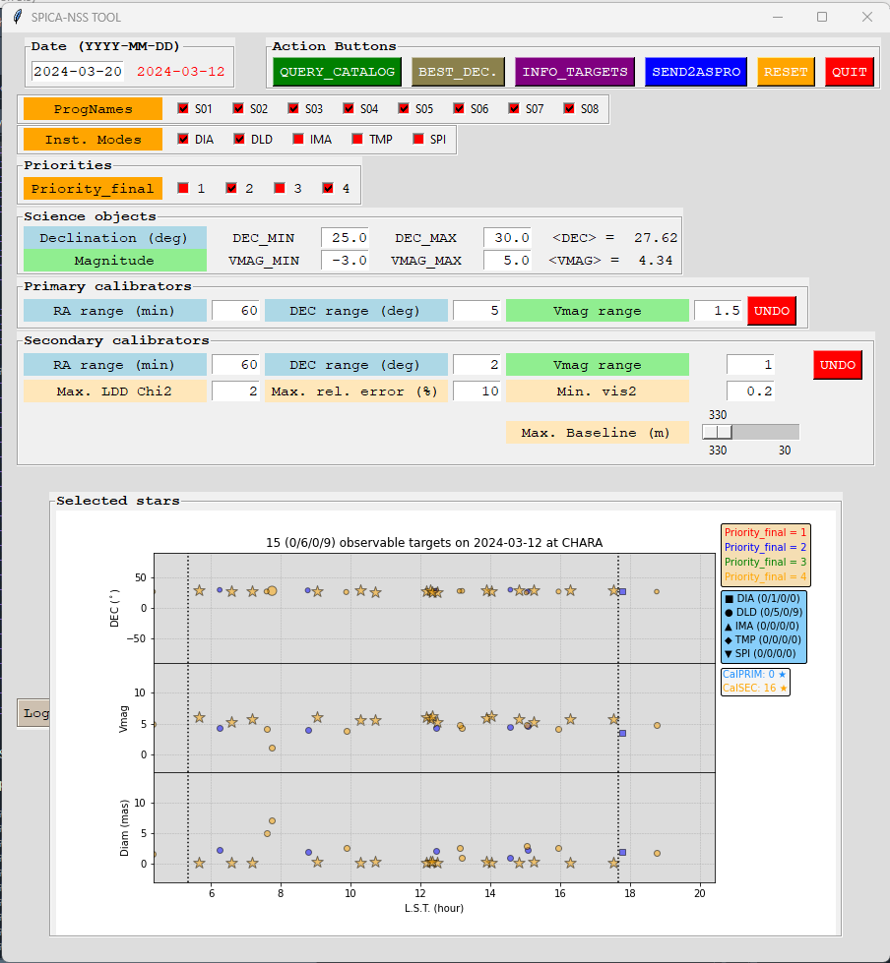
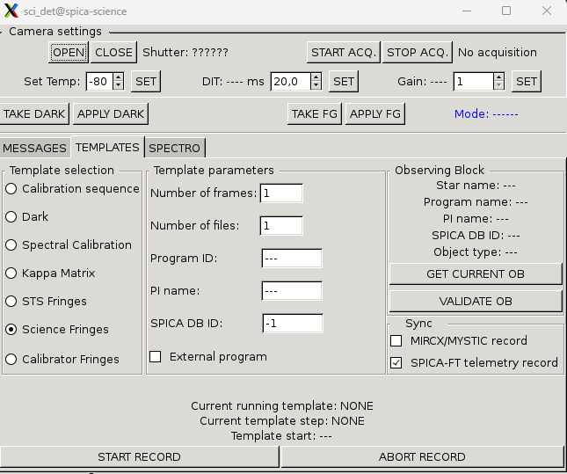

SPICA-VIS commissioning in 2023
All 15 fringes simultaneously on SPICA with MIRCx and MYSTIC (June 23)
Implementation of chromatic OPD validated in September 2023
Organisation of night based on ‘survey mode’ ➔ one data point every 30mn
SPICA Night-Scheduler Software
Catalogue from Interferometric Survey of Stellar Parameters (ISSP)
Filtering on criteria (magnitude, declination…)
Adding Calbrators from ISSP cat. And JSDC
Communication with ASPRO2 for the night management
Then ASPRO-A2P2 to SPICA software for OBs
SPICA-DB and Night Scheduling Software
collaboration

Slide 9
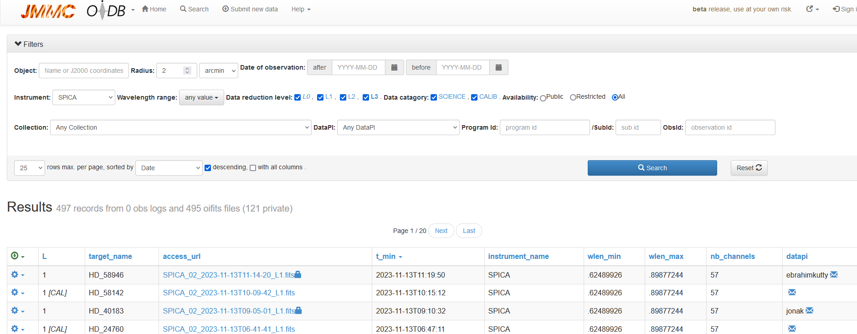
SPICA-VIS commissioning in 2023
All 15 fringes simultaneously on SPICA with MIRCx and MYSTIC (June 23)
Implementation of chromatic OPD validated in September 2023
Organisation of night based on ‘survey mode’ ➔ one data point every 30mn
End of night automatic DRS pipeline ➔ L0 (header) and L1 (uncalibrated data) ➔ OiDB

Slide 10
SPICA-VIS commissioning in 2023
All 15 fringes simultaneously on SPICA with MIRCx and MYSTIC (June 23)
Implementation of chromatic OPD validated in September 2023
Organisation of night based on ‘survey mode’ ➔ one data point every 30mn
End of night automatic DRS pipeline ➔ L0 (header) and L1 (uncalibrated data) ➔ OiDB
Calibration pipeline validated (work for SPICA, MIRCx and MYSTIC data)

Slide 11
SPICA-VIS commissioning in 2023
All 15 fringes simultaneously on SPICA with MIRCx and MYSTIC (June 23)
Implementation of chromatic OPD validated in September 2023
Organisation of night based on ‘survey mode’ ➔ one data point every 30mn
End of night automatic DRS pipeline ➔ L0 (header) and L1 (uncalibrated data) ➔ OiDB
Calibration pipeline validated (work for SPICA, MIRCx and MYSTIC data)
However, there are still some issues…

Slide 12
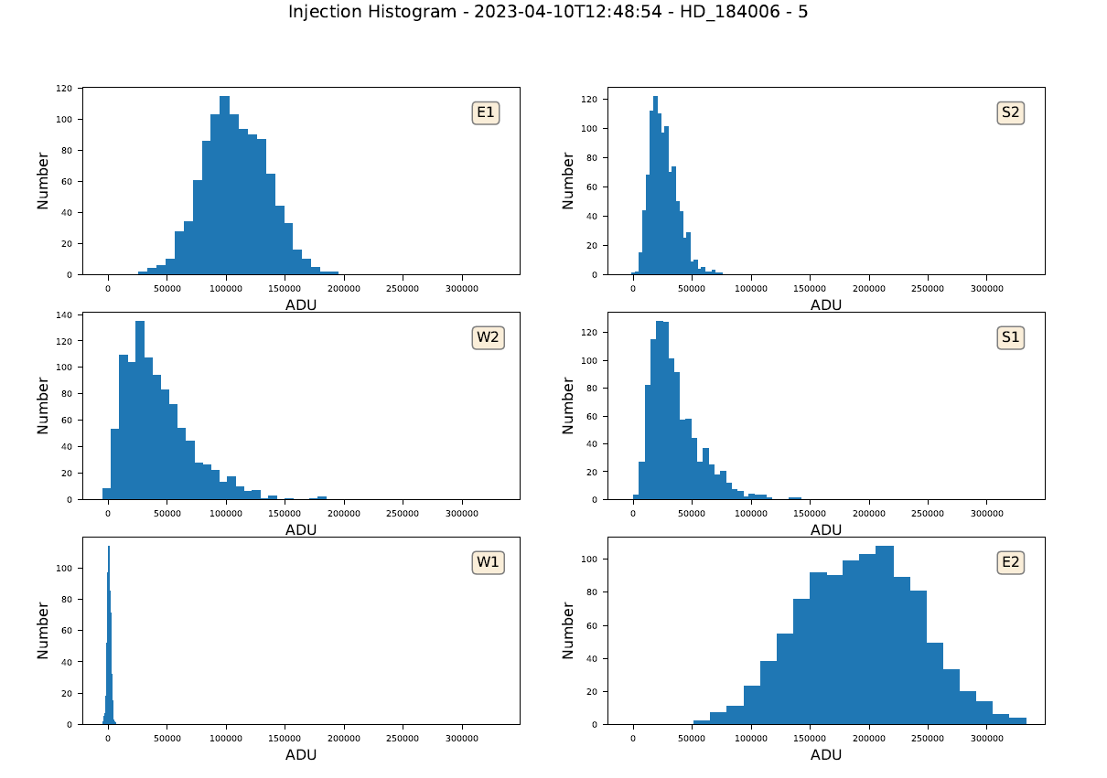
Injection is still quite low
Strehl Ratio ~ 8%
expected 25%
Loss of flux ~ x10
→ 2.5mag
No Tel. AO yet!

Slide 13
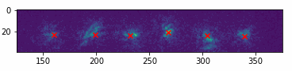
Alignment & image quality to be improved
Strong static aberrations
Infrared and Visible co-alignment procedure not yet robust
→ drifts of images through observation
Notes:
Tu peux peut-être prendre le fichier gif que j’ai envoyé hier, c’est le plus récent et ça montre au moins les 6 AO en fonctionnement mais les aberrations statiques

Slide 14
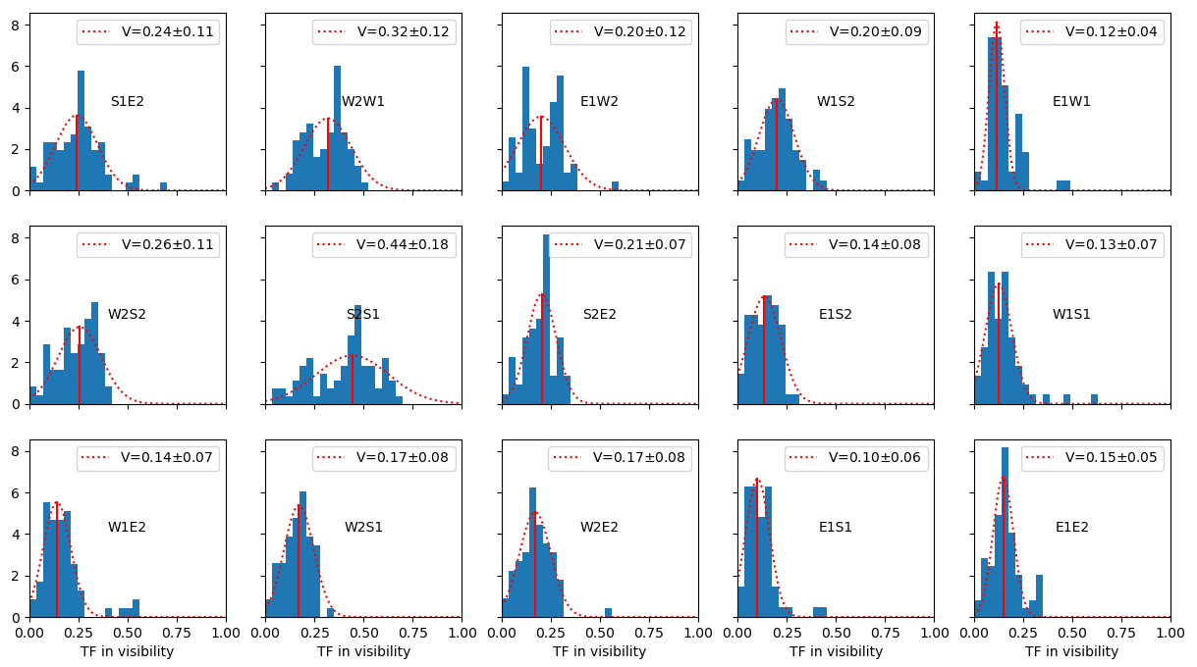
Transfer function on sky is quite-low
a loss in SNR
by a factor 25 compared to the calibration lamp

Slide 15
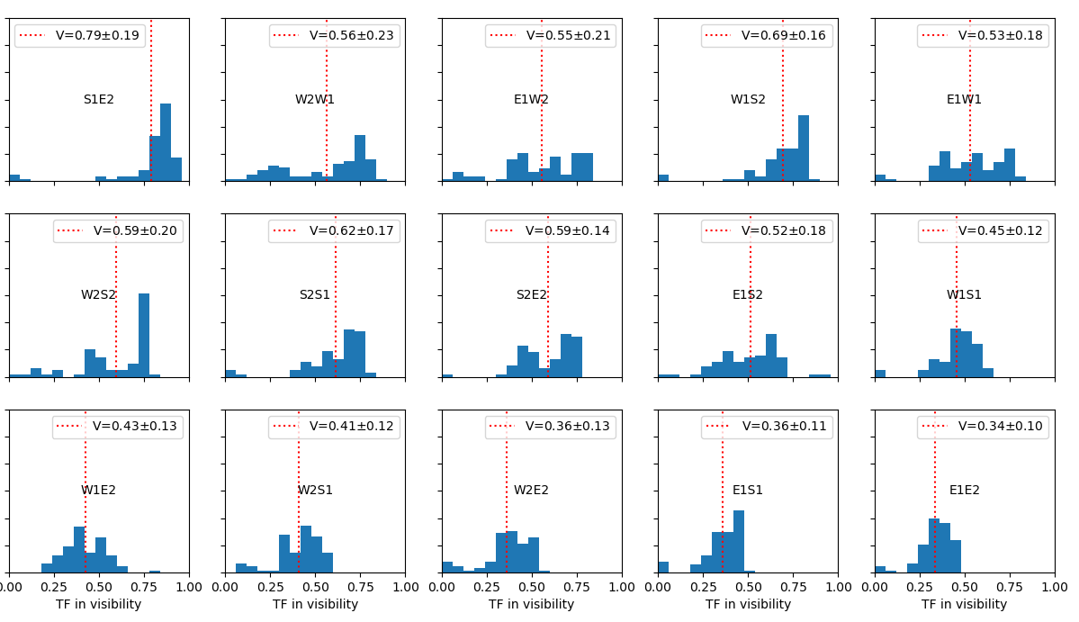
Transfer function on sky is quite-low
a loss in SNR
by a factor 25 compared to the calibration lamp
a CALIBRATION LAMP

Slide 16
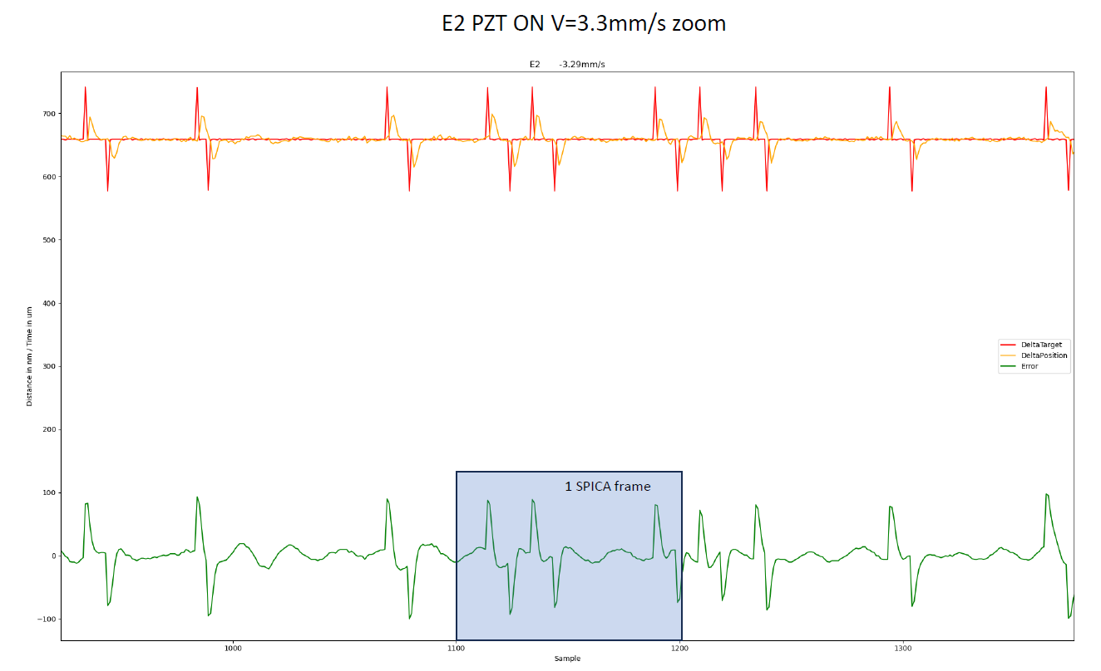
Transfer function on sky is quite-low
a loss in SNR
by a factor 25 compared to the calibration lamp
Important oscillations in the optical delay lines
Investigations under progress
200nm
∼λ/3.5
Notes:
Peut-être inutile de rentrer trop dans ce détail à SPIE.

Slide 17
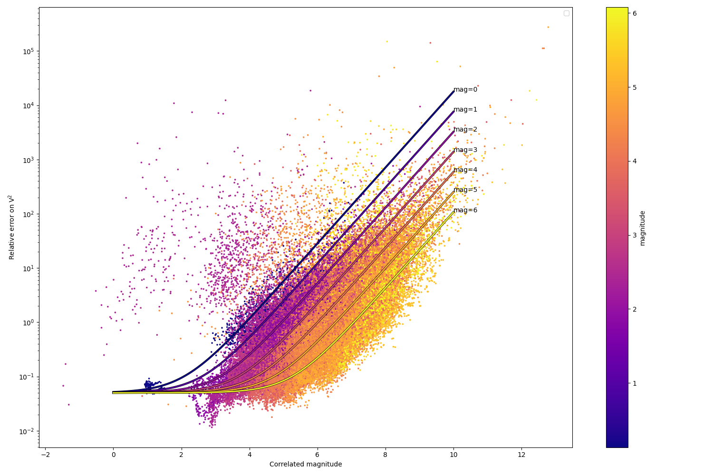
Statistic on V² measurements on sky
Model fitting
errV2 = 0.05+10 ^(0.7*magCorr-2.75-0.37*mag)
Existence of a plateau in V² accuracy of 0.05
not yet understood!
Might be a detector issue

Slide 18

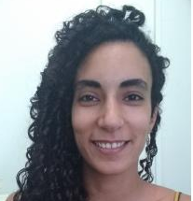
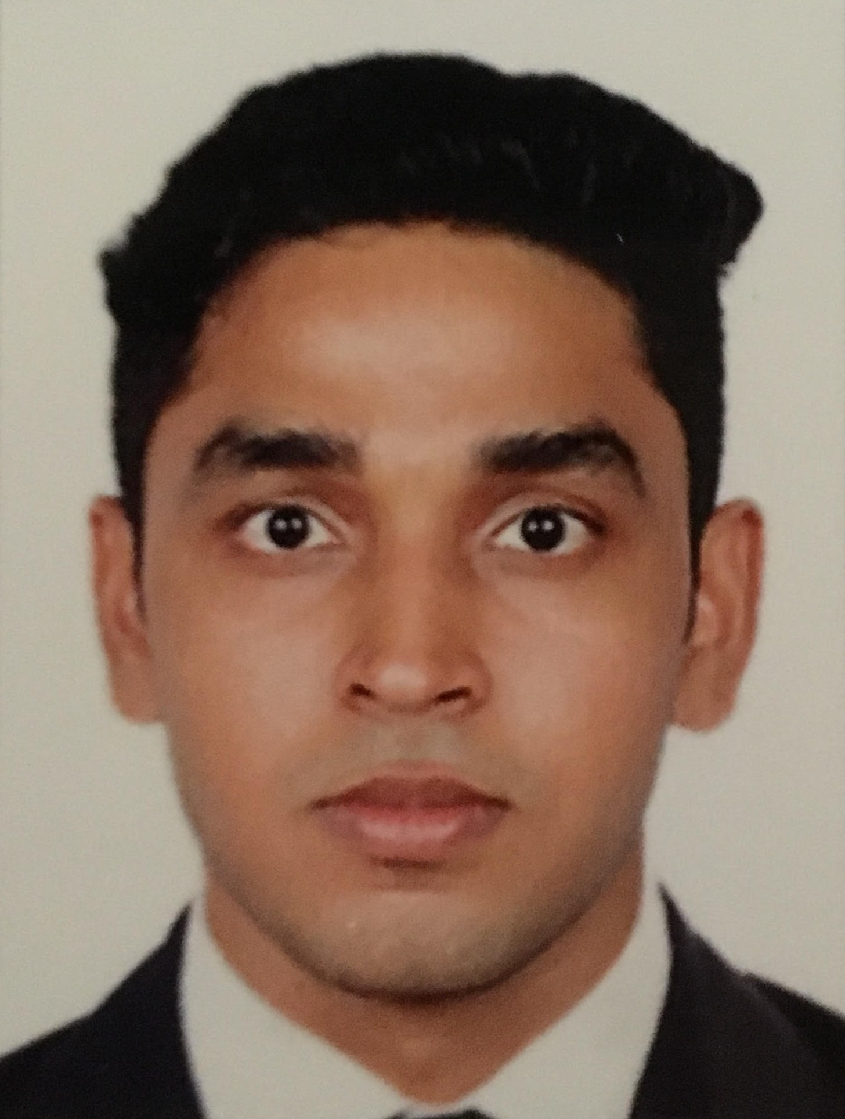

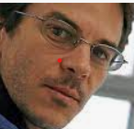





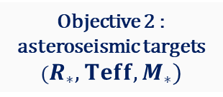
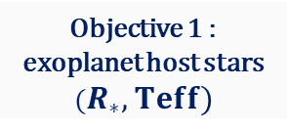
First Science observations
The ISSP science team
From Interferometric Stellar Parameter Survey (ISSP)
radius, mass and age of planets
distances in Universe (Ho)
Transit of exoplanets
Transit of stars
Strong links with:
- ESA/PLATO mission
- Araucaria program
R. Ligi, M. Vrard, R. Ibañez-Bustos, N. Ebrahimkutty, J. Jonak
From Stars to Planets
CoI of the Survey
Stellar evolution
Age
From Bright to Faint stars
Objective 4 : limb-darkening over HR diagram
Objective 5 : Stellar activity over the HR diagram: binarity, rotation, wind & environment
Objective 2 : asteroseismic targets ($R_{∗}, Teff,M_{∗})$
Objective 1 : exoplanet host stars ($R_{∗}, Teff)$
Objective 3 : calibration of Surface Brightness Color Relations (SBCR)
O. Creevey (astero-dwarfs),
S. Deheuvels (astero-giants),
A. Domiciano de Souza (rotating stars),
N. Nardetto (SBCR),
M. Wittkowski (winds), and K. Perraut
$θ_{∗}$ : CHARA/SPICA interferometric observations
of a large sample of stars all over the HR diagram
Control of systematics

Slide 19
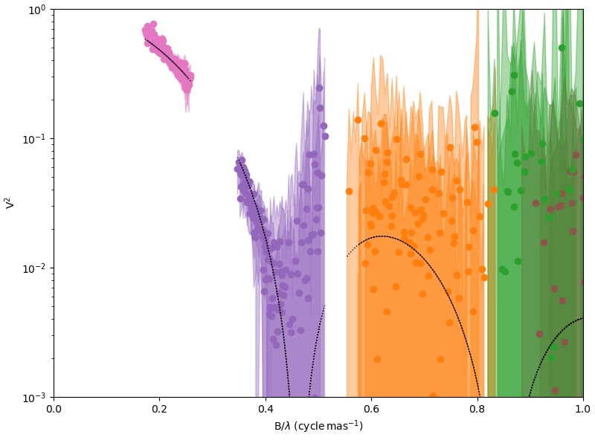
First Science observations
Example of stellar diameter measurement
S1S2
W1W2
HD 222107
mR=3
Noise plateau around V²≈ 0.03
E1E2

Slide 20
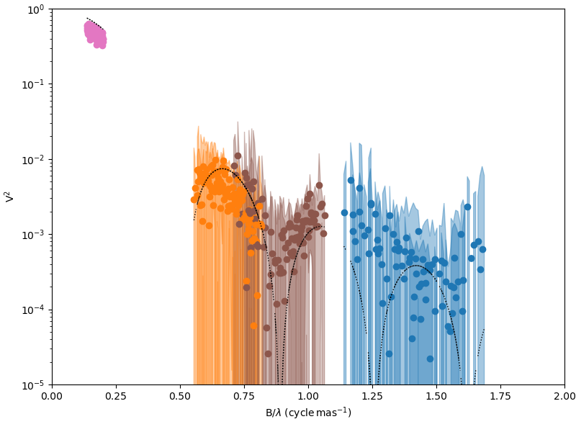
First Science observations
The bright supergiant Rigel
S1S2
mR=0!
W1W2
W2-S2
S1E2
Noise plateau around V²≈ 0.01

Slide 21
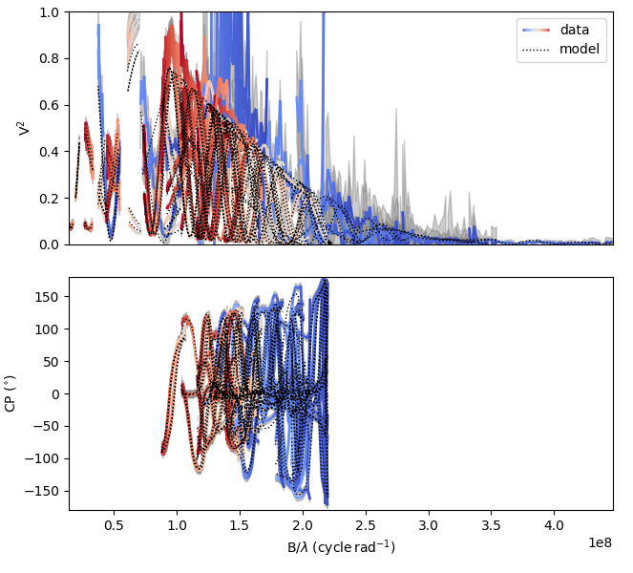
First Science observations
Multi-wavelength study of the Binary Star β Tri
Blue = SPICA (R)
Light Pink = MIRCX (H)
Red = MYSTIC (K)
Simultaneous Data obtained from 0.6 to 2.4µm
Analysis performed by J. Jonak as part of his PhD thesis
Modelling with 2 UDs with chromatic flux ratio
MCMC run to find the best model and estimate parameters and uncertainties
Blue = MIRCX (H)
Red = MYSTIC (K)
No SPICA CP
Juraj Jorak
PhD at Lagrange Lab.

Slide 22
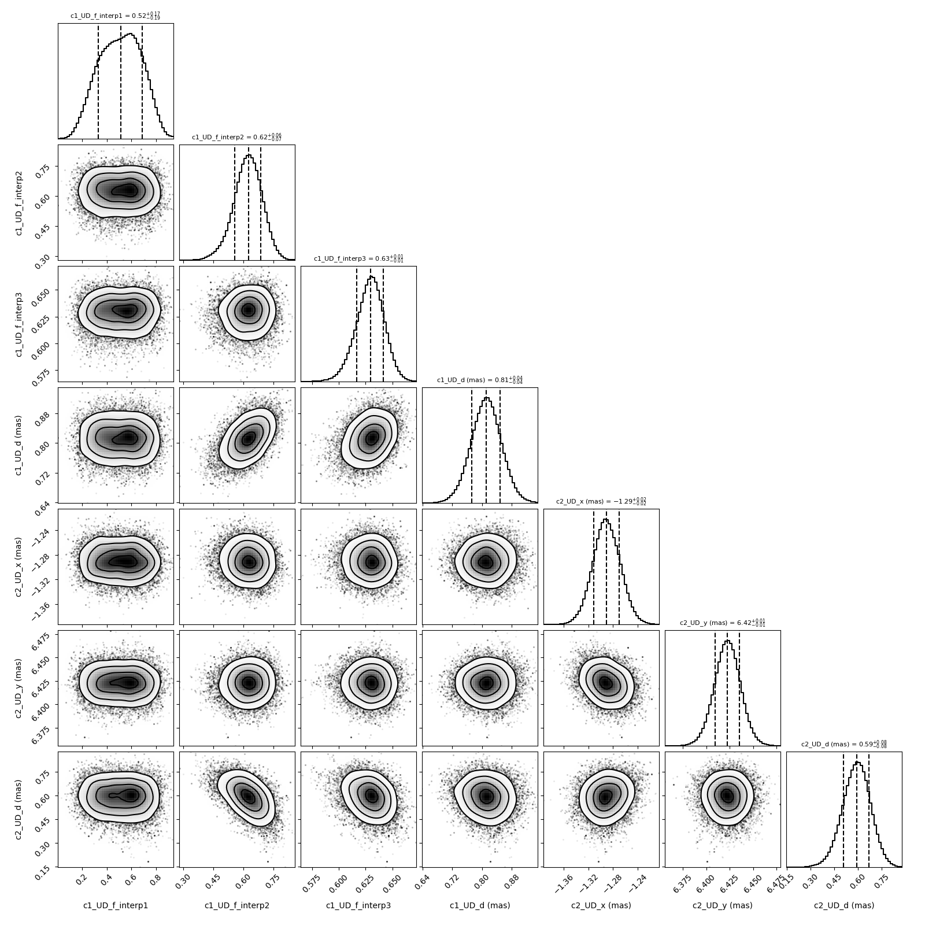
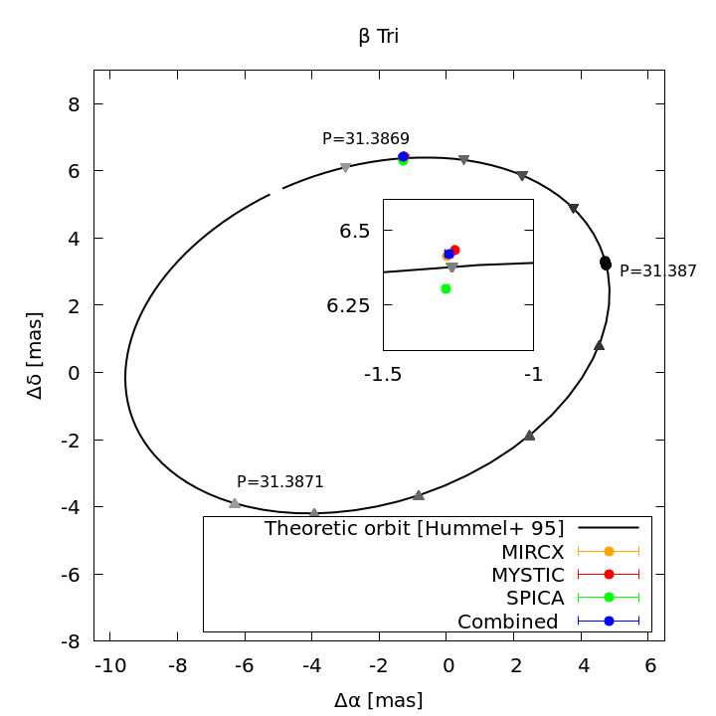
First Science observations
Multi-wavelength study of the Binary Star β Tri seen from 0.6 to 2.4μm
Flux ratios in R, H, K
Diameter 1
X position
Y position
Diameter 2

Slide 23
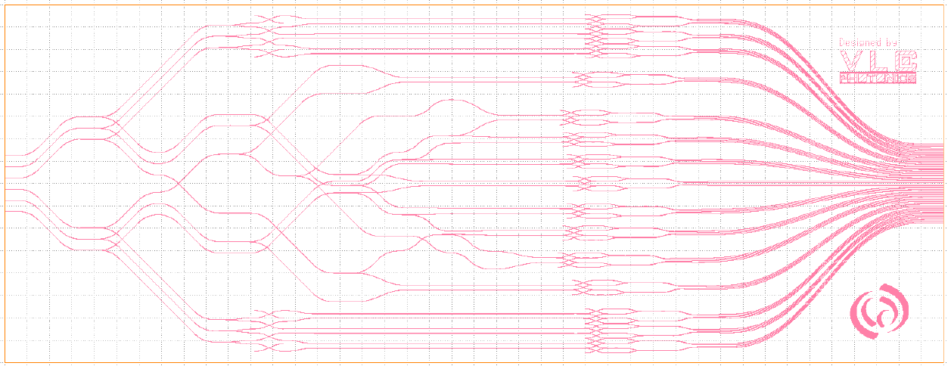
What about SPICA-FT?

Slide 24
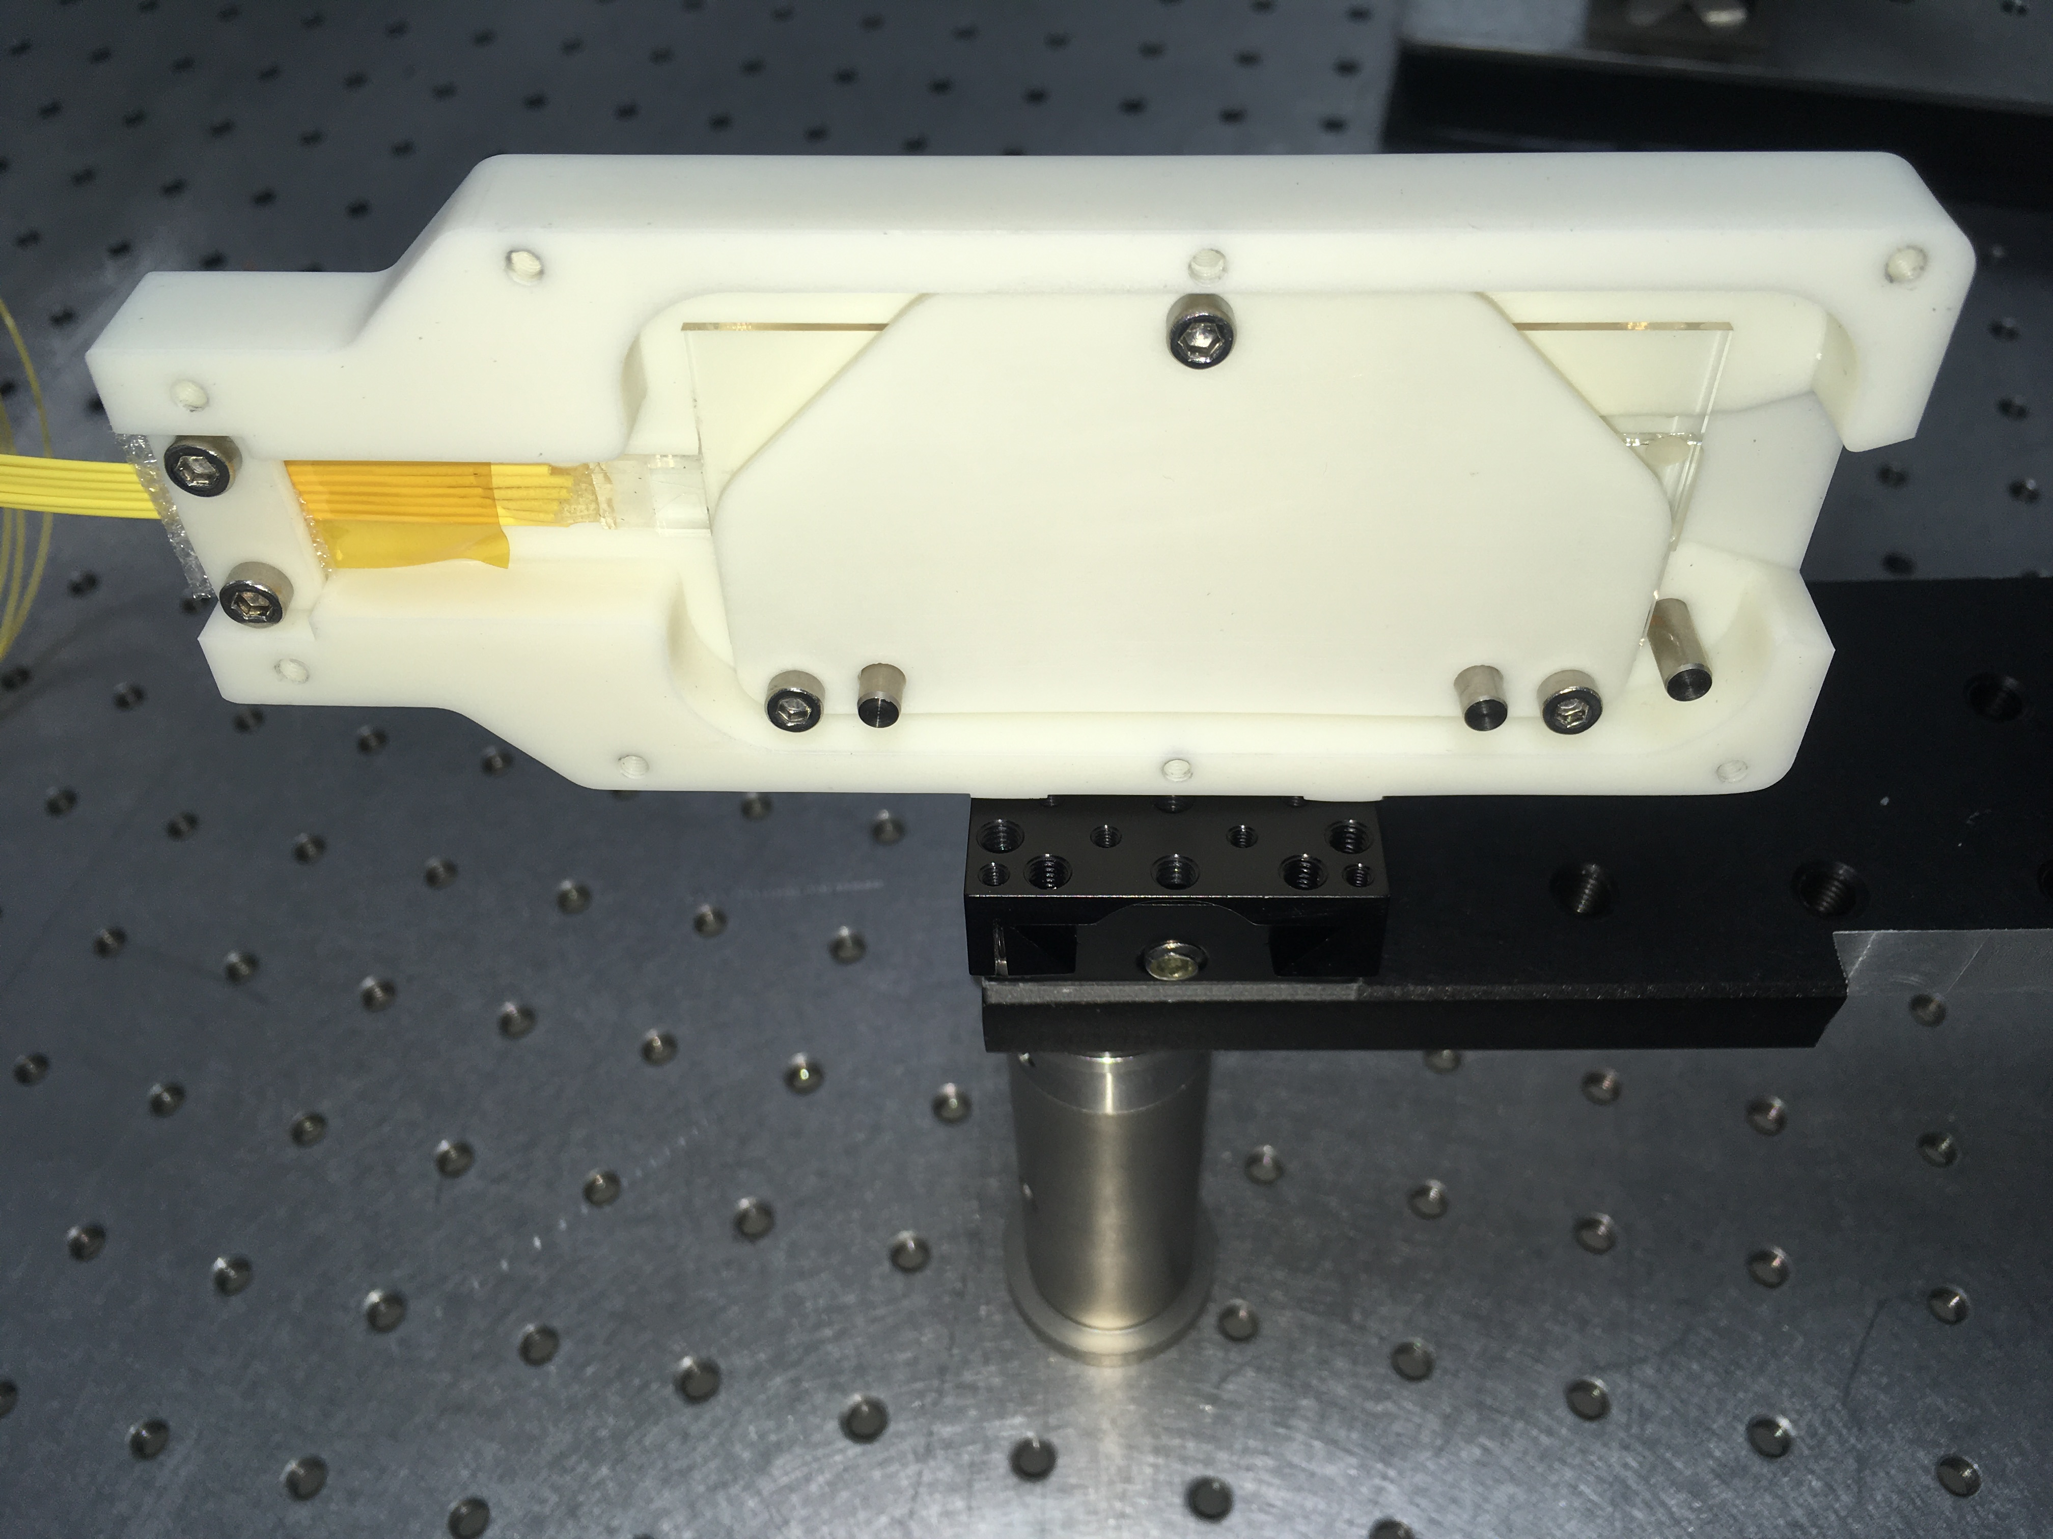
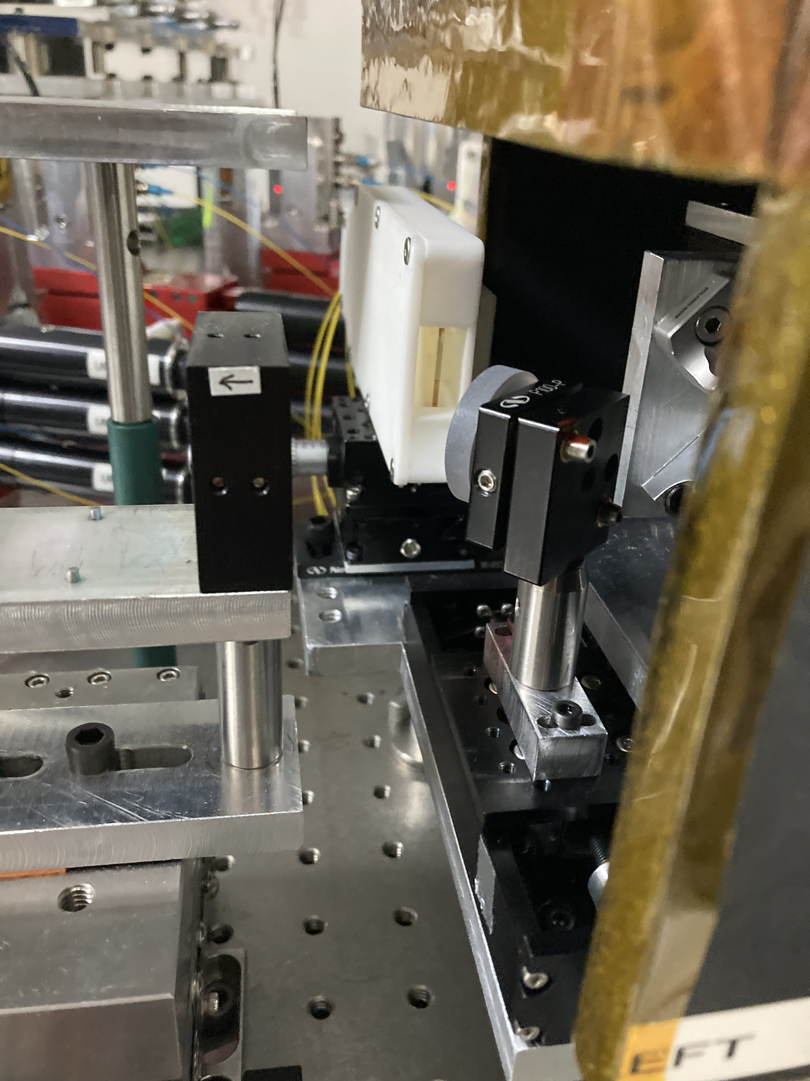
SPICA-FT status
Chip Installation at CHARA
SPICA-FT chip test in Nice in 2022
SPICA-FT chip installed in MIRCX in 2024

Slide 25
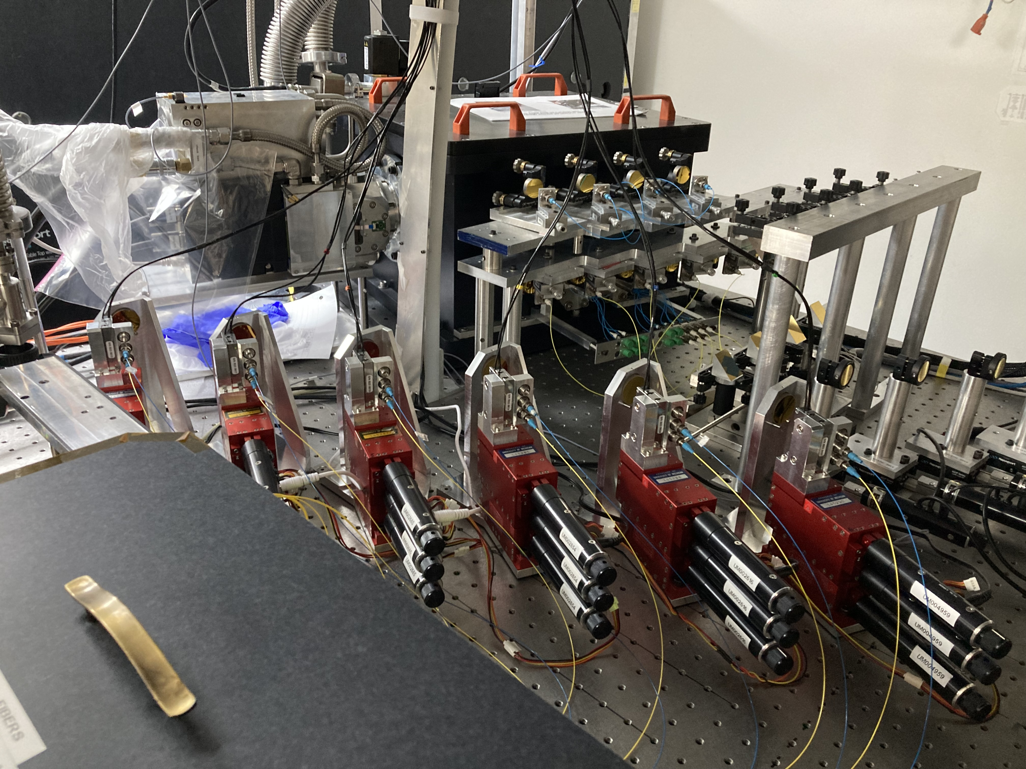
SPICA-FT status
Hardware tests at CHARA
SPICA-FT IO chip ~ 30% gain compared to MIRCx in term of transmission
Automatic switch between the MIRCX-AIO and the SPICA-FT-ABCD
⬄10mn for alignment and cophasing
Notes:
Nous avons changé les paraboles hors axe de MIRCX afin de tirer profit d'une meilleure adaptation à l'injection en présence d'une bonne correction par l'optique adaptative. Pour faire ce travail nous avons démonté entièrement l'injection MIRCX et donc tout réaligné en ajoutant des étages importants pour le contrôle de la pupille. Cela a permis un gain quantitatif sur le flux injecté.

Slide 26
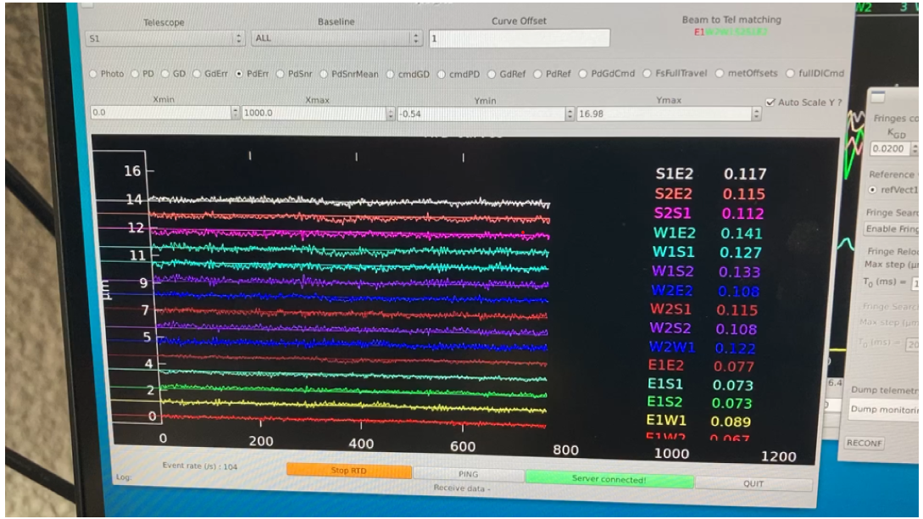
SPICA-FT status
Software tests at CHARA
  Real Time processing for Group Delay and Phase Delay tracking validated (including relocking fringes)
  Good performance but not enough time to use it in science observations
Tracking using
Group Delay & Phase Delay
Freq = 300Hz
rms ≈ 100nm
⬄
λ / 7 for SPICA-VIS
Notes:
Nous avons changé les paraboles hors axe de MIRCX afin de tirer profit d'une meilleure adaptation à l'injection en présence d'une bonne correction par l'optique adaptative. Pour faire ce travail nous avons démonté entièrement l'injection MIRCX et donc tout réaligné en ajoutant des étages importants pour le contrôle de la pupille. Cela a permis un gain quantitatif sur le flux injecté.

Slide 27

Conclusions
SPICA the new 6T visible combiner for the CHARA Array
SPICA-VIS:
  Functional commissioning almost completed in 2023
  Routinely work in Survey mode: Scheduler + ASPRO2 & OIDB integration, data reduction ready
  Limited performances on-sky :
    AO, alignment, DLs vibrations ⬄ current work by the SPICA & CHARA Teams
    0.02 V² “plateau” ⬄ still being investigated ⬄ ANDOR detector issue?
SPICA-FT:
  Successful installation on MIRCX (easy switch for the two modes)
  Software ready for GD & PD including fringe jumps (relocking fringes)
  Next steps:
    Test in routine “science” observations for robustness
    Characterisation on SPICA-VIS sensitivity with longer DIT
Notes:
J’ai enlevé les deux derniers items.

