Slide 1
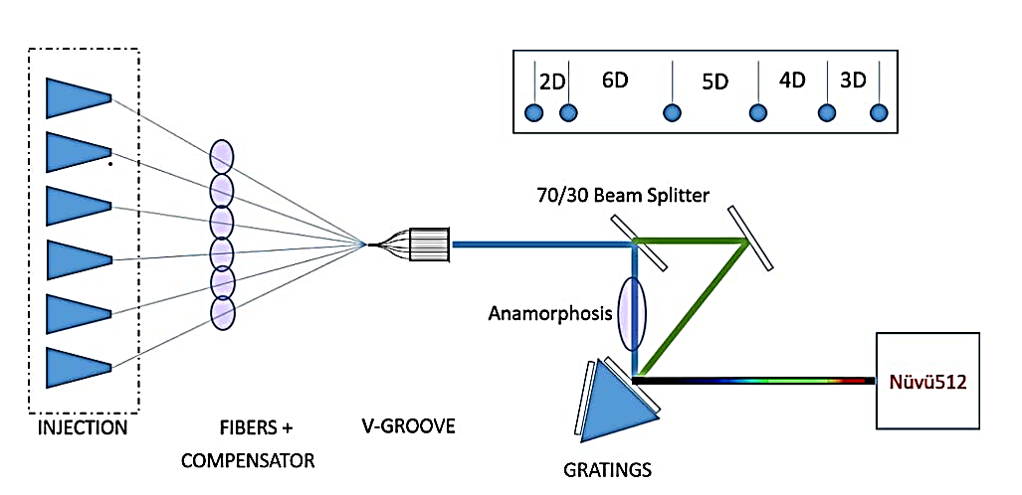
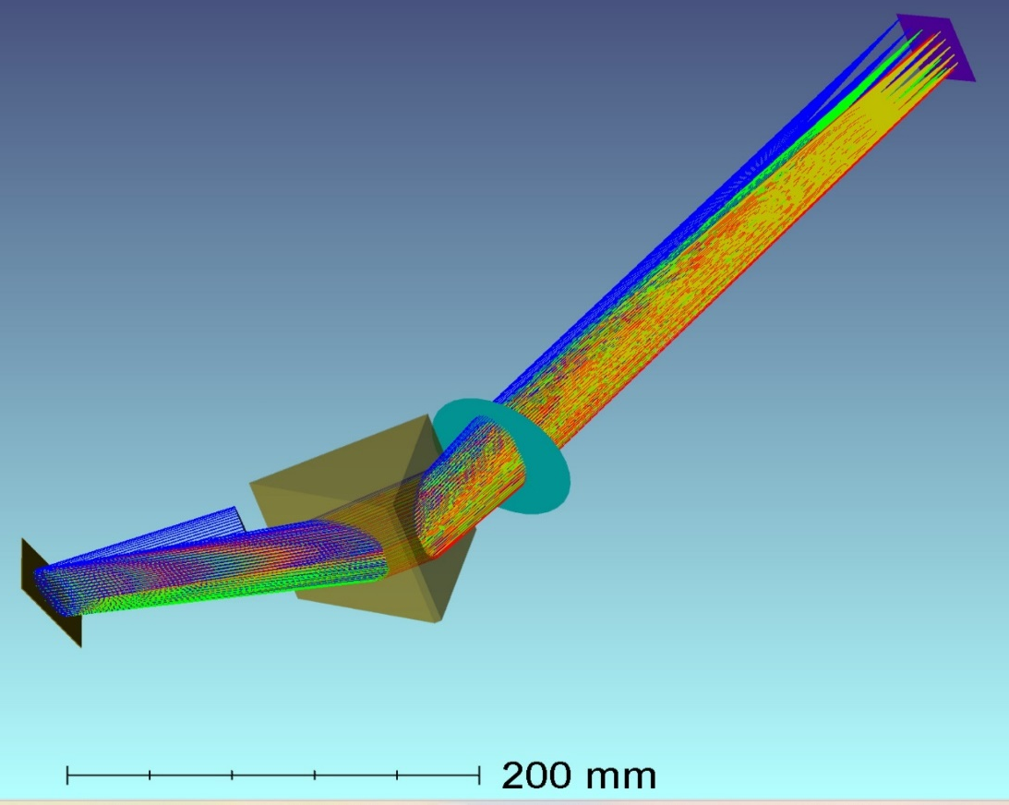
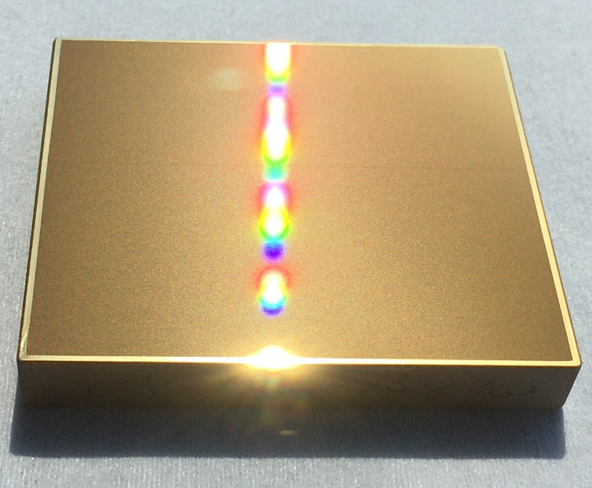
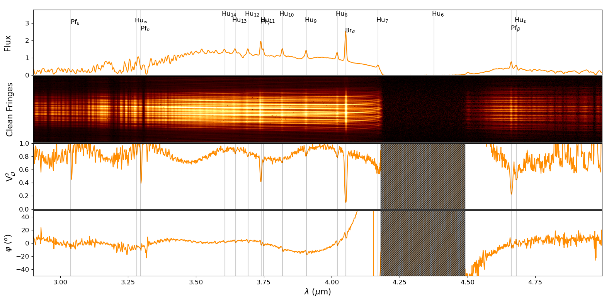
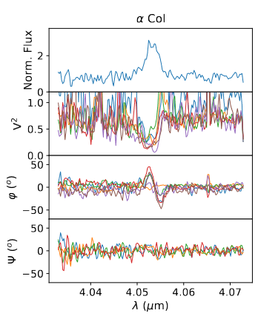
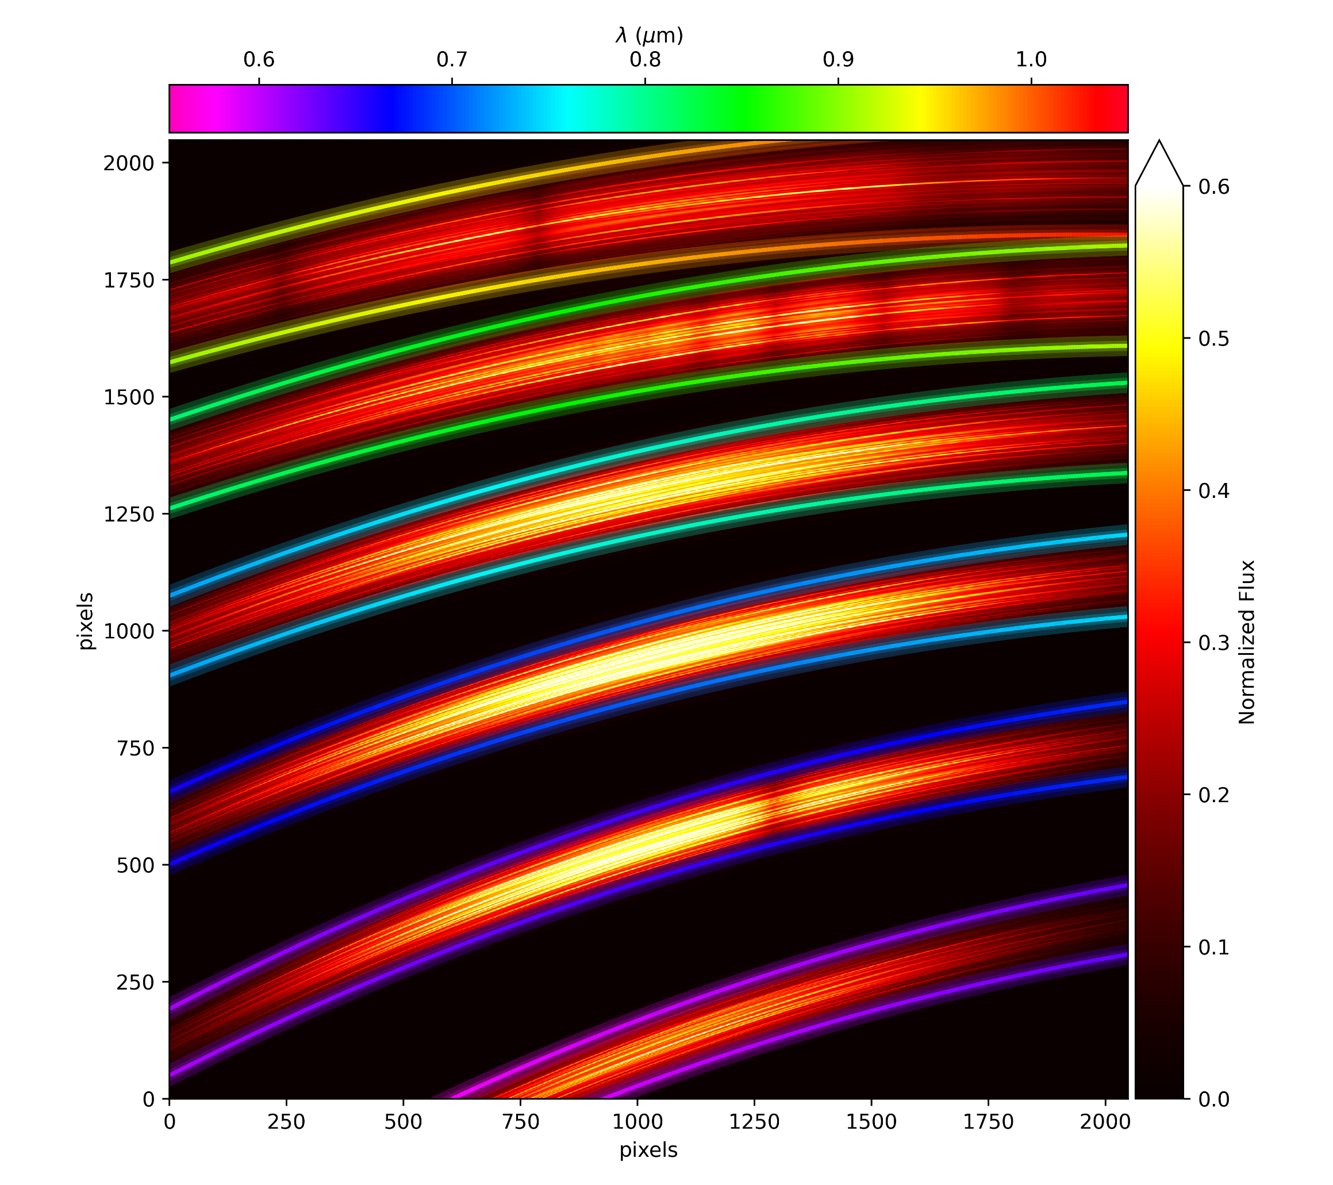
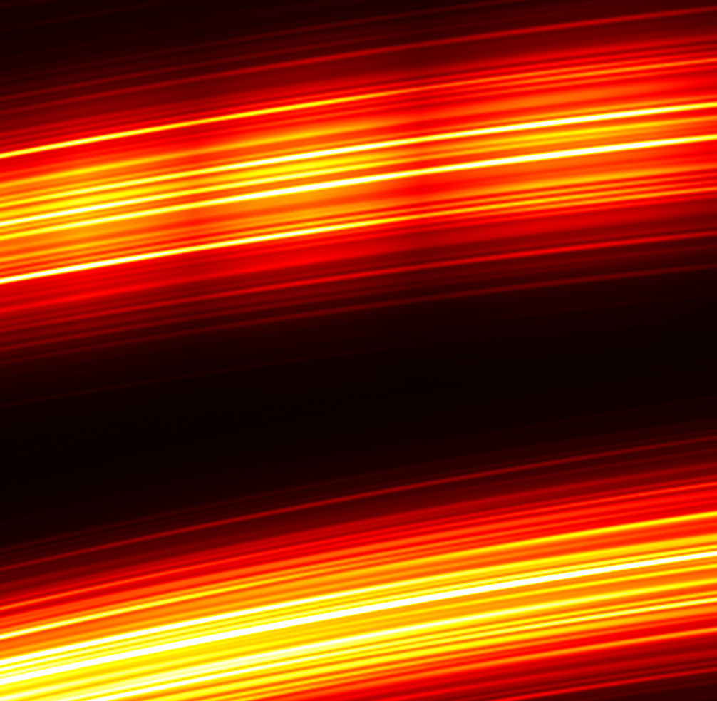
SPINER
SPectro-INterferometry with Echelle grating at high Resolution
A. Meilland¹, F. Millour¹, S. Lagarde¹ & J. Dejonghe¹
1 Laboratoire Lagrange, Université Côte d’Azur – CNRS, France
Astrophysical Context
Designing the SPINER test-bench
High angular resolution is crucial to progress in the understanding of numerous astrophysical phenomena. Although the E-ELT will provide a suitable resolution for some, most of the stellar photospheres of near-by stars will remain unresolved by it.
Long baseline interferometry is then the only technique allowing to reach the milli-arcsecond resolution needed to resolve these objects. Prospective for visible-interferometry¹ has highlighted two main types of scientific programs:
Determining stellar parameters by directly measuring their diameter
Studying the physics of photospheres and close circumstellar environments
While the first category involves little constraints on spectral resolution and coverage of the instruments, the second highlights the interest high spectral resolution to resolve fine spectral structures. Among these programs are:
• Kinematics of photospheres: rotation, pulsations, and convection cells
• Abundance mapping for objects with low inclination and slow rotators
• Shocks and mass loss in stellar winds
• Physical conditions in the chromospheres and extended atmospheres
• Accretion in interacting binaries or for young objects
• Stellar environments: kinematics, chemical composition, physical conditions
Numerous studies have already been carried out using spectro-interferometric instruments at high spectral resolutions: CHARA/VEGA, the visible, VLTI instruments AMBER, GRAVITY and MATISSE in the infrared. However, despite the quality of these studies, they were somehow limited by a trade-off between spectral resolution and spectral bandwidth (see Fig 1 for an example).
SPINER is designed as an evolving interferometric test bench to study the different problems that Echelle spectro-interferometry can pose in terms of optical and mechanical design, transmission, detector, and data analysis. It has been designed to be easily installable as a prototype on the CHARA/SPICA 6 telescopes visible instrument and uses the same pupils’ configuration (see Fig 2a)
The spectral-resolution will be R≈20000, which is the minimum for most of the science-cases. The spectrum will cover the full 600-900nm domain. Initial plan was to go down to 450nm, but the spectral-window was limited by the size of the detector (2048x2048). Moreover, interferometry below 600nm has proven very hard due to atmospheric turbulence and the possibility of decent fringe tracking at such low wavelength is hazardous.
SPINER echelle-spectrograph consists of two dispersers :
an Echelle-grating : 75 traits/mm, with a 17.45° blaze used at orders 9 to 12 (see Fig 2c)
a 60° prism for transverse dispersion with V_{d}=25.16 n_{d} = 1.805
(a)
(b)
(c)
Fig 2: (a) Schematic layout of the SPICA pupils. (b) Optical design of the SPINER spectrograph. (c) photo of SPINER echelle grating.
The 600-900nm spectrum is divided on 4 orders, dispersed a 2048x2048 camera. Note that part of the 8th and 13th orders are also visible on the detector. The smallest fringes is sampled on 3 pixels and the spectral sampling is also 3 pixels. Fig 3 shows a simulation of SPINER fringes pattern with non-zeros optical path difference on the 6 beams.
Fig 1: Comparison between VLTI/MATISSE observations of two classical Be stars at different spectral resolutions: δ Cen (left) at R ≈ 500 covering the whole L-M bands (3-5μm) and showing multiple emission lines, and α Col (right) at R ≈ 4000 covering only a short band around Brα emission line. From MATISSE general description paper²
Instrumental context
To enhance the spectral-band of spectro-interferometric instruments at very high spectral resolution we aim at testing the combination of interferometry with dispersion of the Echelle-spectroscopy type which would make it possible to take the best advantage of the large size and square format of current detectors by dispersing the spectrum in two dimensions. This type of dispersion has proven itself in spectroscopy and spectro-polarimetry (UVES, X-Shooter, NARVAL), but its combination with interferometry has never been tested.
Beyond lab tests, a spectro-interferometric-echelle instrument would need the following conditions that are either already available at VLTI and CHARA or in development:
low noise EMCCD
Efficient adaptive optics systems on the telescopes
Spatial filtering through optical-fibers
efficient fringe-tracker allowing to “freeze” fringes for many seconds
ACKNOWLEDGEMENTS
Fig 2: Simulation of SPINER fringes for a 12000K star on the 2048x2048 pixels camera. Wavelength is indicated by the colour of the glowing lines framing the fringe pattern
The SPINER project is funded by Observatoire de la Côte d’Azur, the Lagrange Laboratory, and the ANR project MASSIF
Conclusion & Perspectives
REFERENCES
The SPINER project aims at testing the possibility of Echelle-spectro-interferometry for a future generation of instrument at CHARA & VLTI focusing mainly on the visible domain where very high spectral-resolution is needed.
The integration of the SPINER test-bench will start in September 2024 in Nice and should be finished before the end of the year. The in-lab characterization of the instrument and its fringe pattern will go on in the first half of 2025, as well as a development of a thorough simulator with inputs for the test-bench, the CHARA infrastructure, the SPICA instrument (AO, fringe-tracker, transmission), and from potential science cameras for future on-sky tests.
1 Science cases for a visible interferometer
Stee Ph., Allard F., Benisty L et al. 2017 arXiv0502395s
2 MATISSE, the VLTI mid-infrared imaging spectro-interferometer
Lopez, B.; Lagarde, S.; Petrov, R. G. et al. 2022, A&A 659, 192
3 SPICA: a 6T visible combiner for the CHARA array
D. Mourard, P. Bério, K. Perraut et al. 2017, JOSA-A,.34, 5, A37

