Slide 1
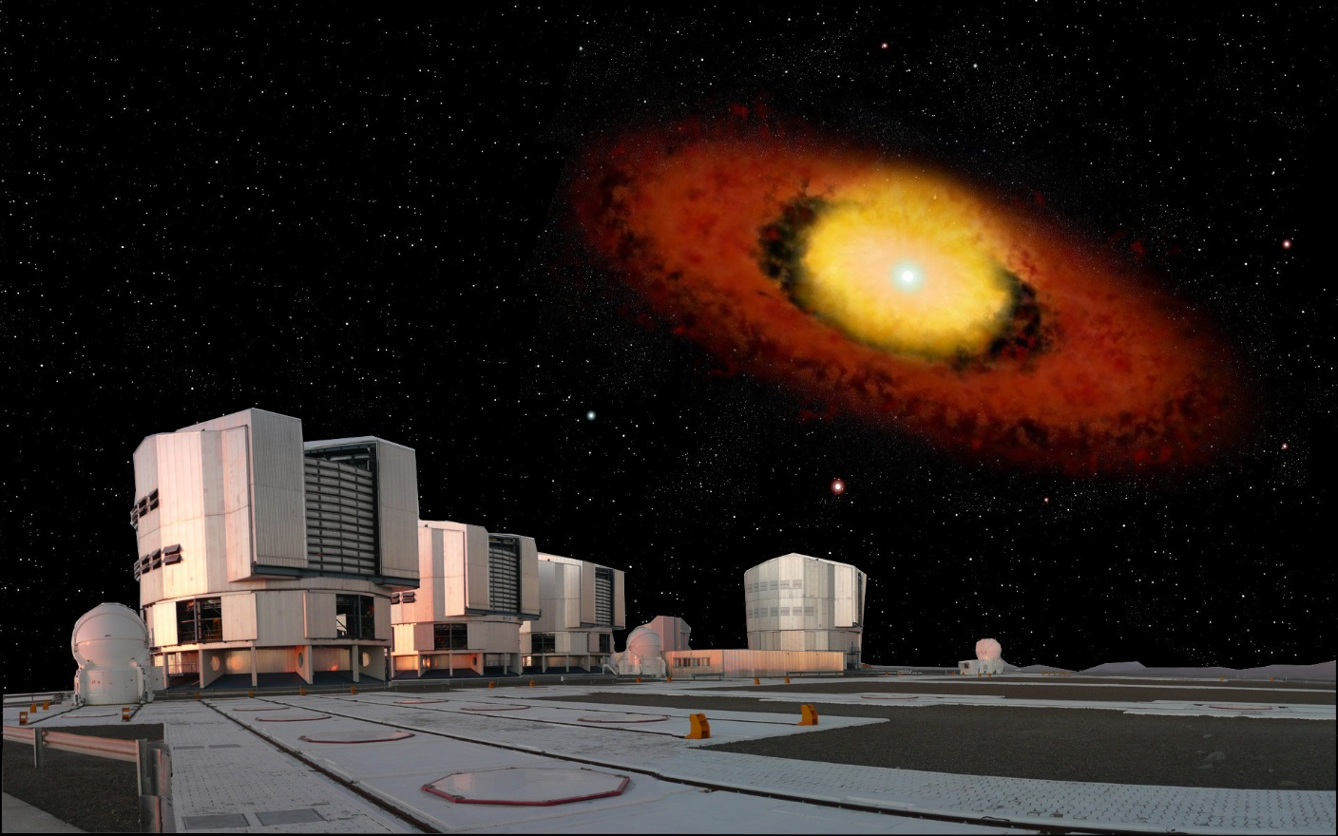




Probing gas and dust around B[e] stars at the highest angular resolution:
A decade of interferometric studies
Anthony Meilland

Slide 2
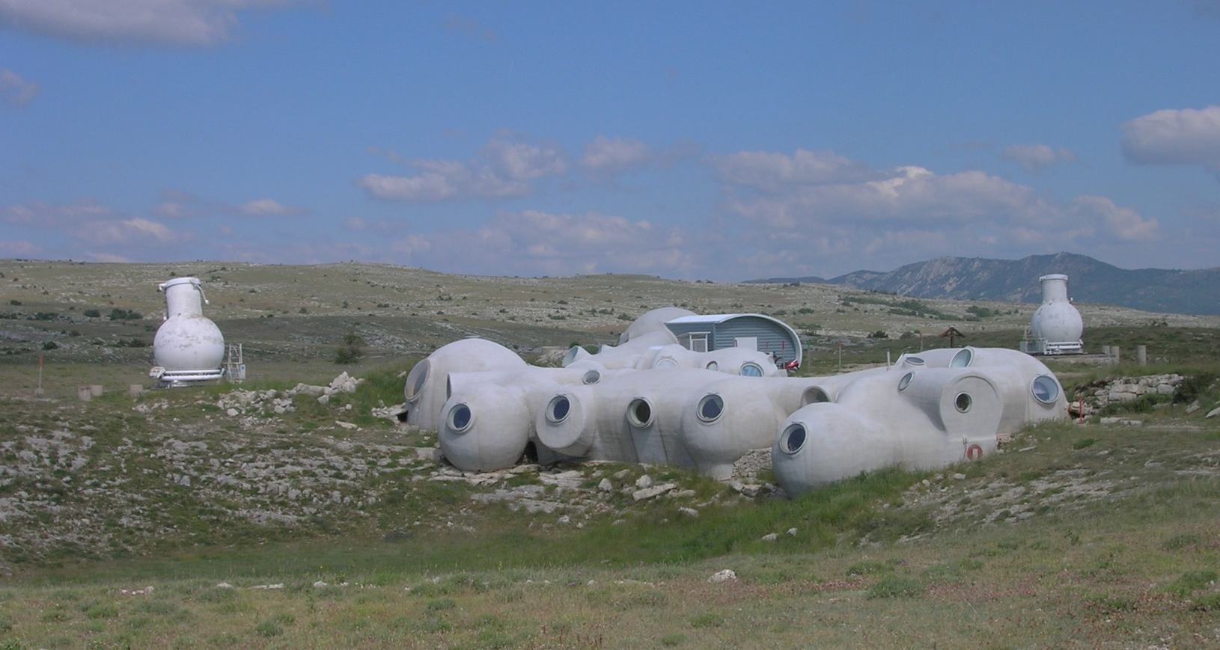
Long baseline interferometry 101
Diameter
Baseline
Angular resolution :
Telescope => 1.22 D/λ
Interferometer => 1.22 B/ λ
The « old » GI2T at Observatoire de la Côte d’Azur, France
1) Long baseline interferometry 101

Slide 3
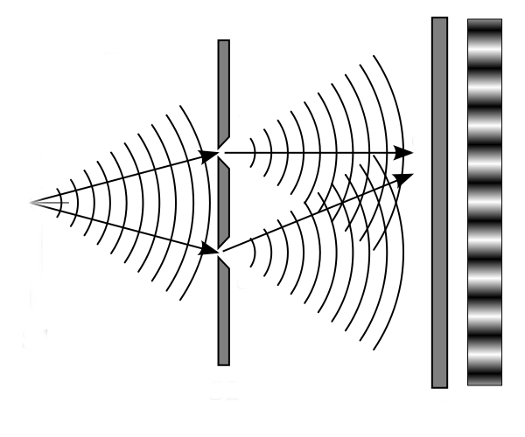
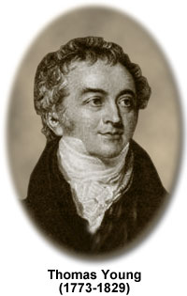
Thomas Young’s slit experiment (1801)
a) Let there be fringes
1) Long baseline interferometry 101

Slide 4
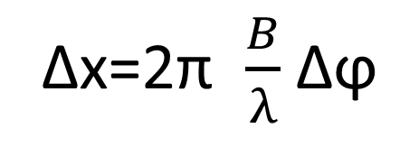
Thomas Young’s slit experiment (1801)
Moving the source
Δx
Fringes phase change
Δϕ
Δx=2π $\frac{B}{λ}$ Δϕ
a) Let there be fringes
1) Long baseline interferometry 101

Slide 5
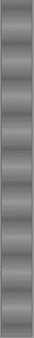
Thomas Young’s slit experiment (1801)
Increasing the source size
+
+
+
…
=
θ
B
Loss of
fringe contrast!
The fringes even disappear for θ=1.22 λ/B !
a) Let there be fringes
1) Long baseline interferometry 101

Slide 6
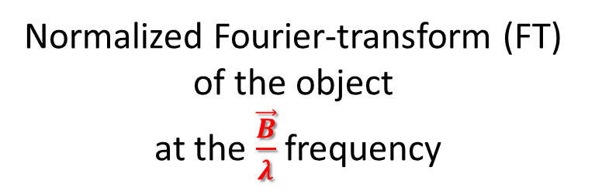
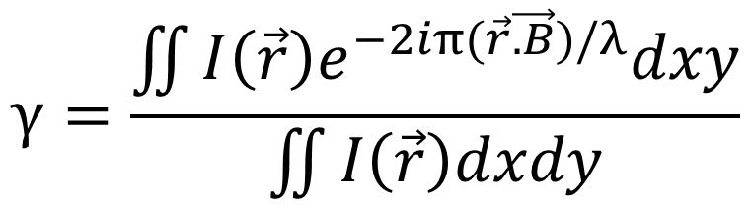
Van Citter & Zernike theorem
$$γ=\frac{\iint{I\left(\vec{r}\right)e^{−2iπ(\vec{r}\vec{.B})/λ}dxy}}{\iint{I\left(\vec{r}\right)dxdy}}$$
Complex visibility
=
γ=Ve^{iϕ}
Normalized Fourier-transform (FT)
of the object
at the $\frac{\vec{B}}{λ}$frequency
Fringe contrast
Fringe phase
b) Living in the Fourier space
1) Long baseline interferometry 101

Slide 7


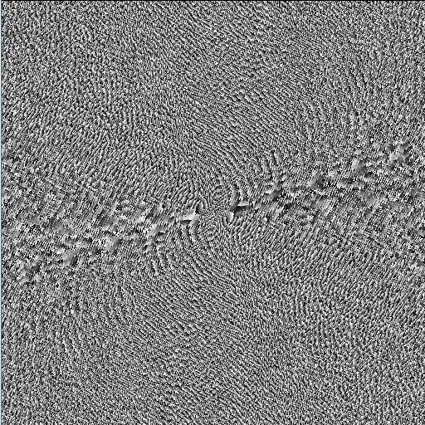
Sampling the object FT ⬄Filling the (u,v) plan
Modulus
Phase
Inverse Fourier transform
FT⁻¹
What is that?
Oh it’s a Zebra!
Need a lot of measurements
with baselines of different orientations and lengths
b) Living in the Fourier space
1) Long baseline interferometry 101

Slide 8
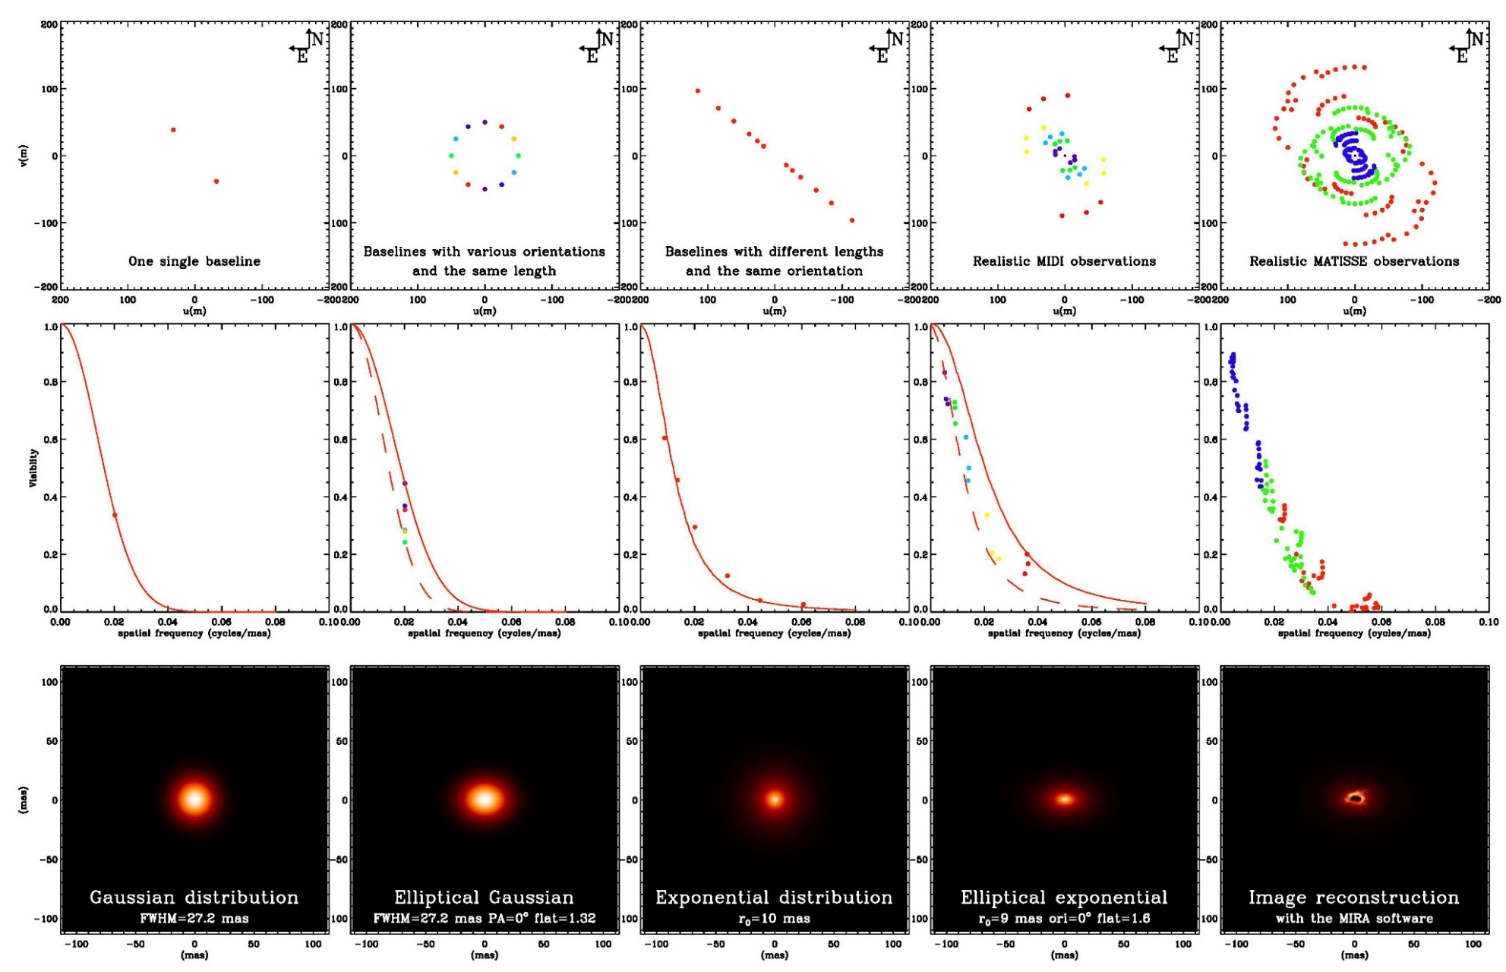
In the real life we always have a sparse (u,v) plan coverage
(u,v) plan
Visibility
Model
Equivalent size
Flattening
Radial profile
``Complex’’ model
Image reconstruction
b) Living in the Fourier space
1) Long baseline interferometry 101

Slide 9
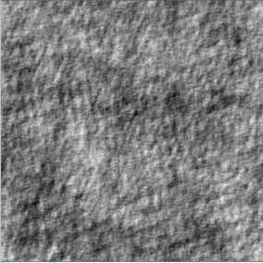


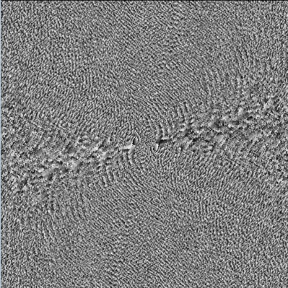
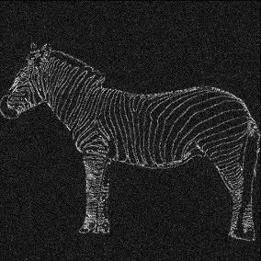
The phase contains most of the information!
Modulus
FT⁻¹
Random map
FT
Phase
FT⁻¹
b) Living in the Fourier space
1) Long baseline interferometry 101

Slide 10
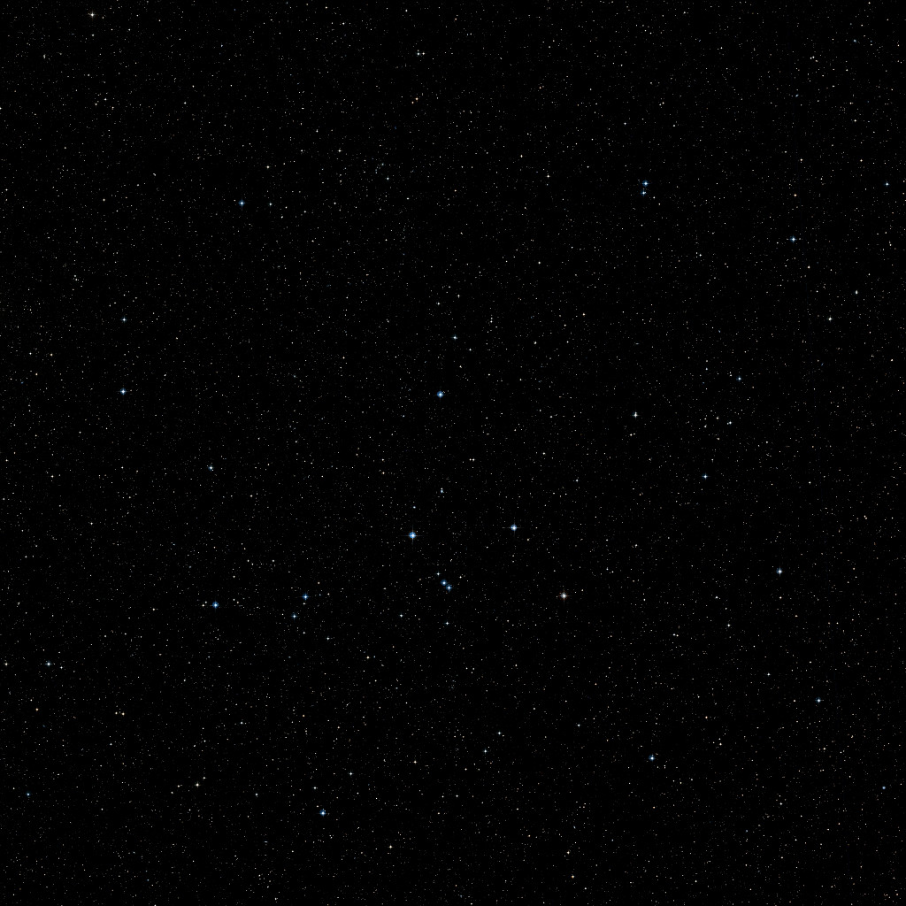

Idealistic situation
Optical Path Difference
Delay Line
c) I want my phase back!
1) Long baseline interferometry 101

Slide 11
Unfortunately, Earth has an atmosphere!
Atmospheric phase δϕ₁(t)
φ₁₂=ϕ₁₂ +δϕ₂- δϕ₁
Atmospheric phase : δϕ₂(t)
c) I want my phase back!
1) Long baseline interferometry 101

Slide 12
The closure phase is our only hope (up to now)
1
ϕ_{ij} = « True » phase for the ij baseline
δϕ_{i} = Atmospheric « random » phase on telescope i
φ_{ij} = Measured phase for the ij baseline
φ₃₁=ϕ₃₁ +δϕ₁- δϕ₃
φ₁₂=ϕ₁₂ +δϕ₂- δϕ₁
3
2
φ₂₃=ϕ₂₃ +δϕ₃- δϕ₂
Closure phase
CP = φ₁₂ + φ₂₃ + φ₃₁ = ϕ₁₂ + ϕ₂₃ + ϕ₃₁
Non zero (% π) Closure phase ⬄ Assymetry of the object
c) I want my phase back!
1) Long baseline interferometry 101

Slide 13
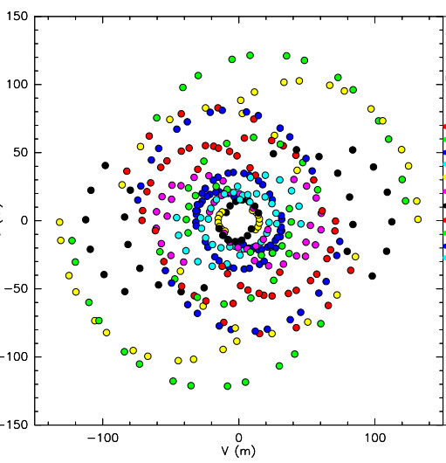

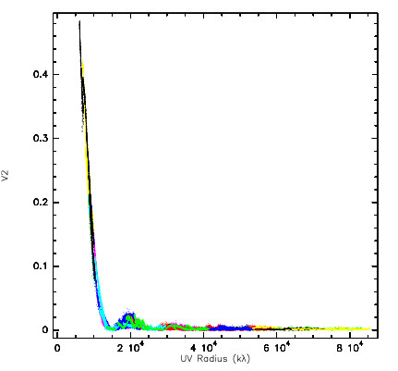
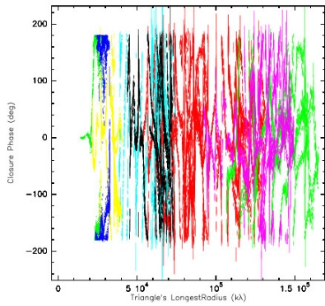
Image reconstruction
N_{x}N_{y} pixels 32x32=1024
Free parameters
Additional priors
  Positivity
  Normalization
Model fitting
but
more free parameters than data
4n of observations
with the VLTI/AMBER
Regularizations methods
  Smoothness
  Compactness
  “Simplicity”
  …
Add even stronger constraints depending on the object
All flux inside a surface (for stellar surface)
Remove unresolved object (for circumstellar disk)
N_{v²}= 102
N_{CP}= 34
= 136 Measurements
d) We want images!
1) Long baseline interferometry 101

Slide 14
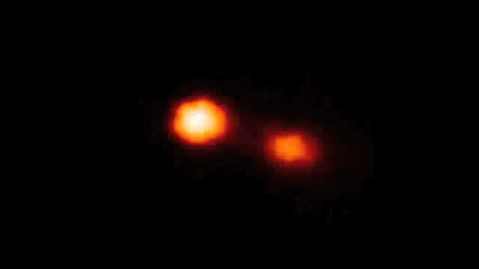
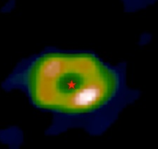

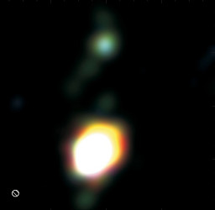
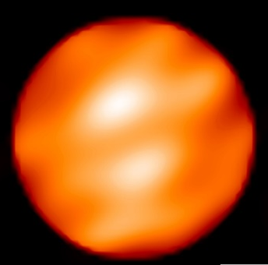
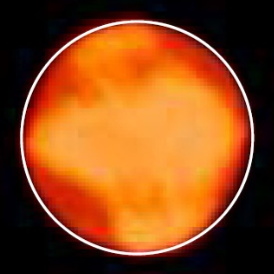



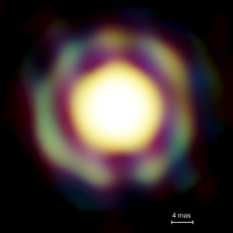
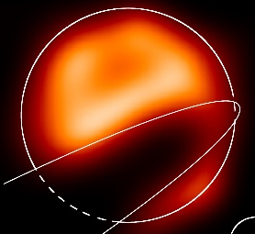

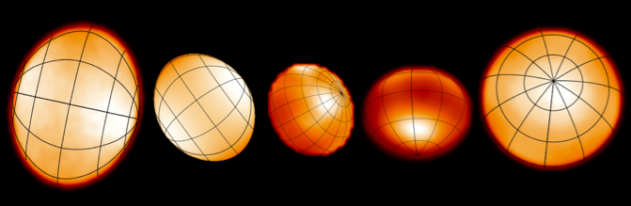

A few images from optical interferometers
Binaries (Interacting, symbiotics, B[e]…)
Dust disks Inner rims
Giants and Supergiants
Kluska+ 2014
Zhao+ 2008
Kraus+ 2012
Benisty+ 2011
Blind+ 2014
Baron+ 2014
Millour+ 2009
Haubois+ 2009
Mira stars
ε Aur
very massive YSO disks
Fast rotators
Kraus+ 2010
Monnier+ 2007, Zhao+ 2009, Che+ 2011
Le Bouquin+ 2009
Kloppenborg+ 2009
d) We want images!
1) Long baseline interferometry 101

Slide 15


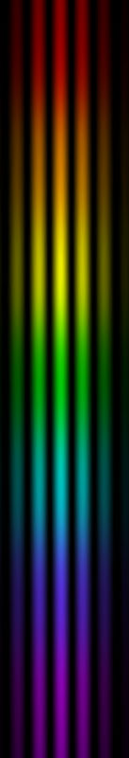
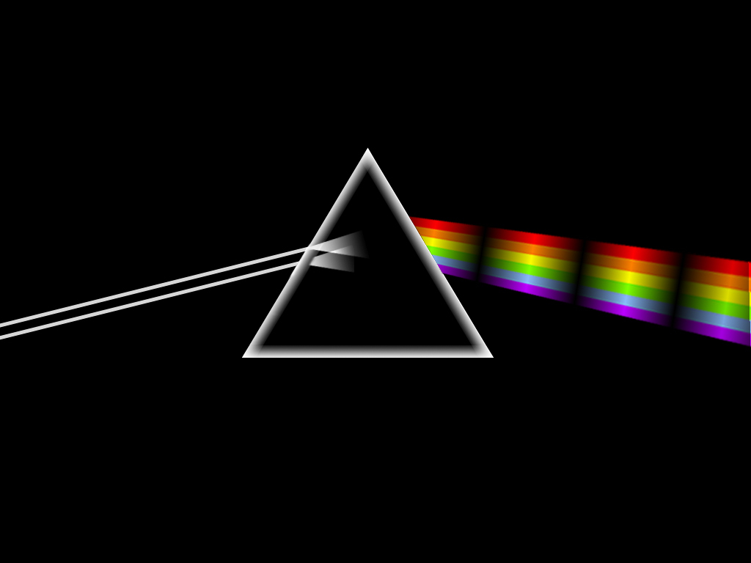
Spectro-interferometry
Spectroscopy
Interferometry
Flux as the function of wavelength
Geometry of objects
Spectro-interferometry
Geometry of objects as a function of the wavelength
e) Any color you like
1) Long baseline interferometry 101

Slide 16
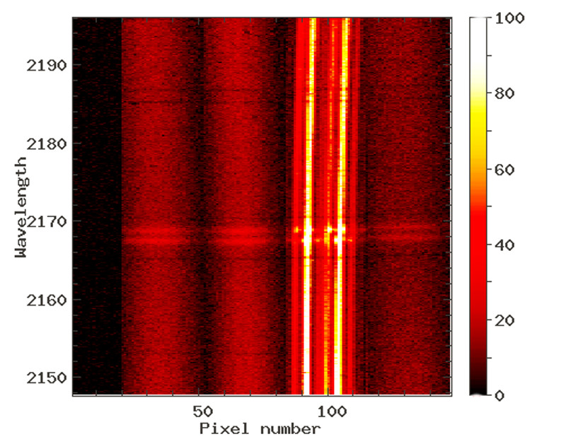
Quantities extracted from spectro-interferometry
Absolute quantities => need of a calibrator
Calibrated visibility V(λ)
Size of object as function of λ
Closure phase φ(λ) (if 3 telescopes or more)
Asymmetry of object as function of λ
Spectrum F(λ)
Differential quantities => no calibrator needed
Differential phase : ϕ(λ)
Variation of photocenter position as a function of λ
Differential visibility : v(λ)
Variation of extension as a function of λ
VLTI/AMBER fringes on the Be star O Aqr around Brγ line
e) Any color you like
1) Long baseline interferometry 101

Slide 17
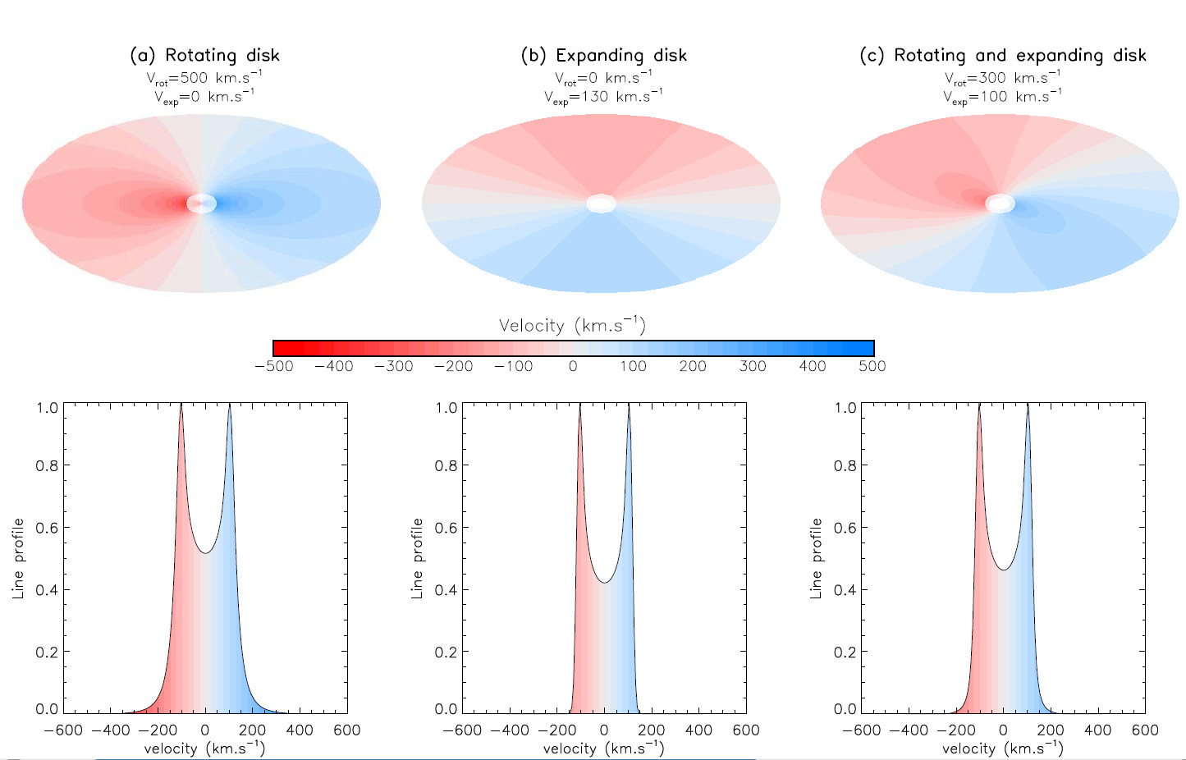
Kinematics with or without angular resolution
e) Any color you like
1) Long baseline interferometry 101

Slide 18
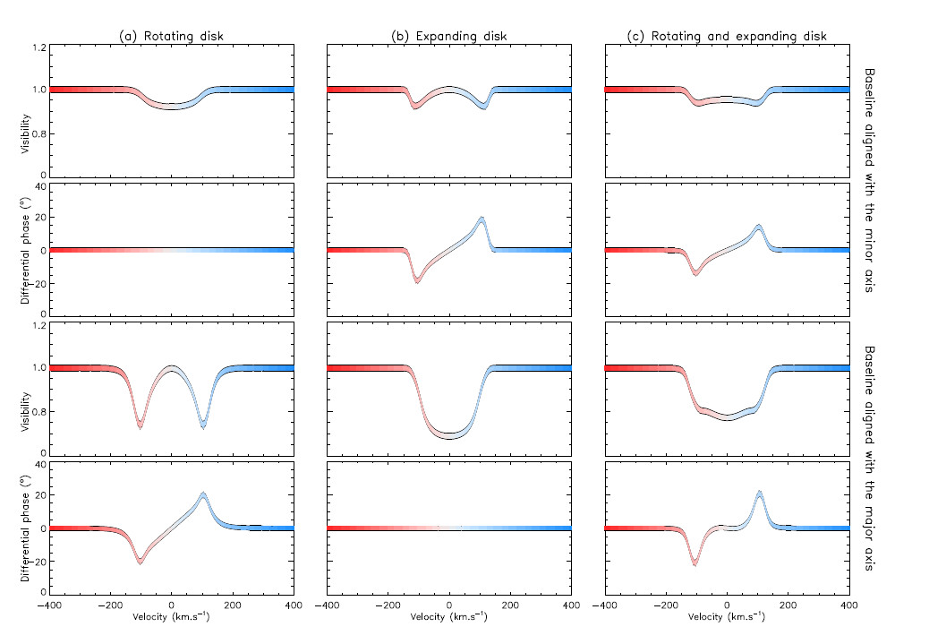
Kinematics with or without angular resolution
e) Any color you like
1) Long baseline interferometry 101

Slide 19
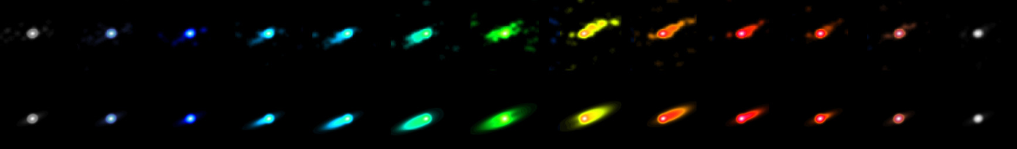
Spectro-interferometric imaging
The binary Be star ϕ Persei seen by CHARA/VEGA (Hα) Mourard+ 2015 (submitted)
Reconstructed images from the VEGA data
Nearly edge-on Keplerian disk model
Spectro-imaging of the classical Be star Phi Disk in Hα (Mourard+ 2015)
e) Any color you like
1) Long baseline interferometry 101

Slide 20
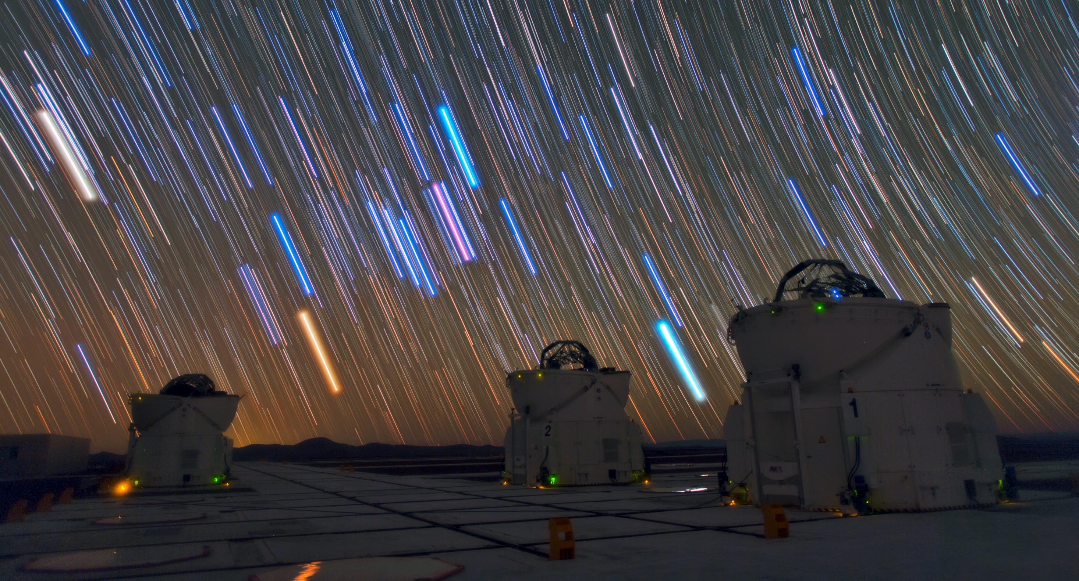
Our interferometric journey around B[e] stars
VLTI auxiliary telescopes
2) Our interferometric journey around B[e] stars

Slide 21
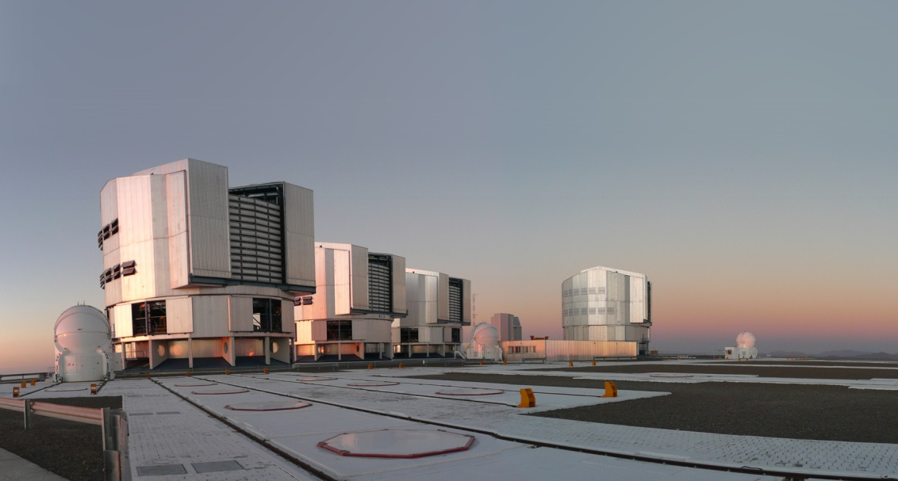
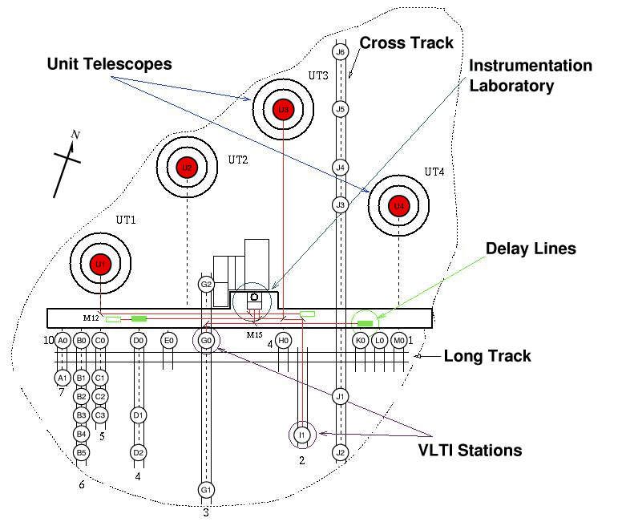
VLTI, Cerro Paranal, Chile
From Meilland+ 2010
Fixed 8.2m
Telescopes (UTs)
Movable 1.8m
Telescopes (ATs)
a) A decade of observations
2) Our interferometric journey around B[e] stars

Slide 22
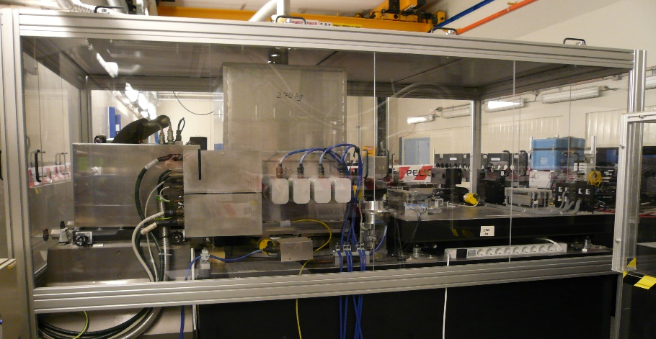
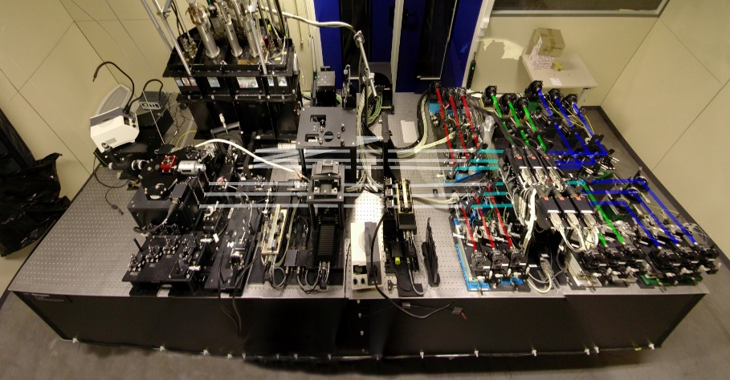
VLTI, Cerro Paranal, Chile
MIDI(2003 – 2015)
2 Tels( 1 V², no CP)
N band (8 - 13 µm)
R=30 (and R=230)
F > 1 Jy
AMBER (2004 - ????)
3 Tels (3 V², 1 CP)
H and K bands (1.6 - 2.4 µm)
R_{LR}=30, R_{MR}=1500, and R_{HR}=12000
mK < 9
a) A decade of observations
2) Our interferometric journey around B[e] stars

Slide 23
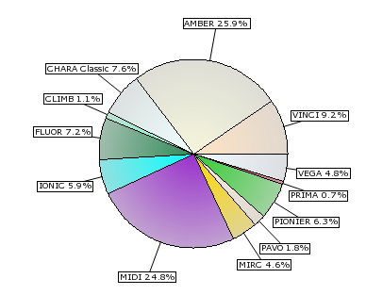
A decade of observations
8 with VLTI/MIDI
10 with VLTI/AMBER
2 with CHARA/VEGA
2 with IOTA/IONIC
1 with VLTI/PIONIER
1 with PTI
Name | Type of B[e] | Reference | Array/Instrument
HD62623 | Supergiant/binary? | Meilland+ 2010 | VLTI/MIDI
 |  | Millour+ 2011 | VLTI/AMBER
HD50138 | Herbig or Unclassified | Borges Fernandes+ 2011 | VLTI/MIDI & VLTI/AMBER
 |  | Ellerbroek+ 2015 | VLTI/AMBER & CHARA/VEGA
 |  | Kluska+ 2016 | VLTI/PIONIER
HD87643 | Herbig or Unclassified? | Millour+ 2009 | VLTI/MIDI & VLTI/AMBER
CPD -57° 2874 | Supergiant | Domiciano de Souza+ 2007 | VLTI/MIDI & VLTI/AMBER
 |  | Domiciano de Souza+ 2011 | VLTI/MIDI
HD85567 | Herbig or Unclassified? | Wheelwright+ 2013 | VLTI/AMBER
 |  | Vural+ 2014 | VLTI/AMBER
MWC300 | Herbig or Unclassified? | Wang+ 2012 | VLTI/AMBER
Hen 3-1191 |  | Lachaume+ 2007 | VLTI/MIDI
V921 Sco | Unclassified | Kreplin+ 2012 | VLTI/AMBER
HD45677 | Herbig or Unclassified | Monnier+ 2006 | IOTA/IONIC
GG Car | Supergiant | Domiciano de Souza+ 2015 | VLTI/MIDI
MWC361 | Herbig | Benisty+ 2013 | CHARA/VEGA
MWC 84 | Supergiant/binary | Thureau+ 2009 | IOTA/IONIC & PTI
HD327083 | Supergiant/binary | Wheelwright+ 2012 | VLTI/AMBER
CPD -52° 9243 | Supergiant | Cidale+ 2012 | VLTI/MIDI
Refereed papers published
by instrument (for all kind of object)
From JMMC database
a) A decade of observations
2) Our interferometric journey around B[e] stars

Slide 24
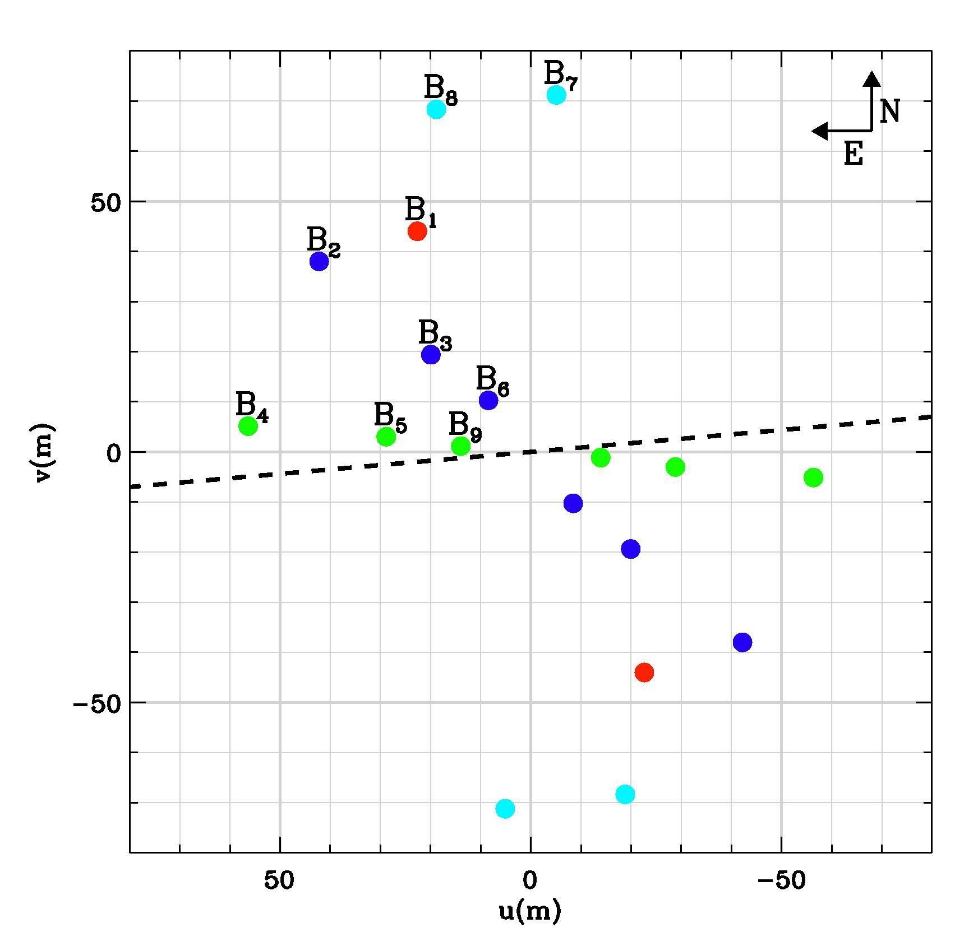
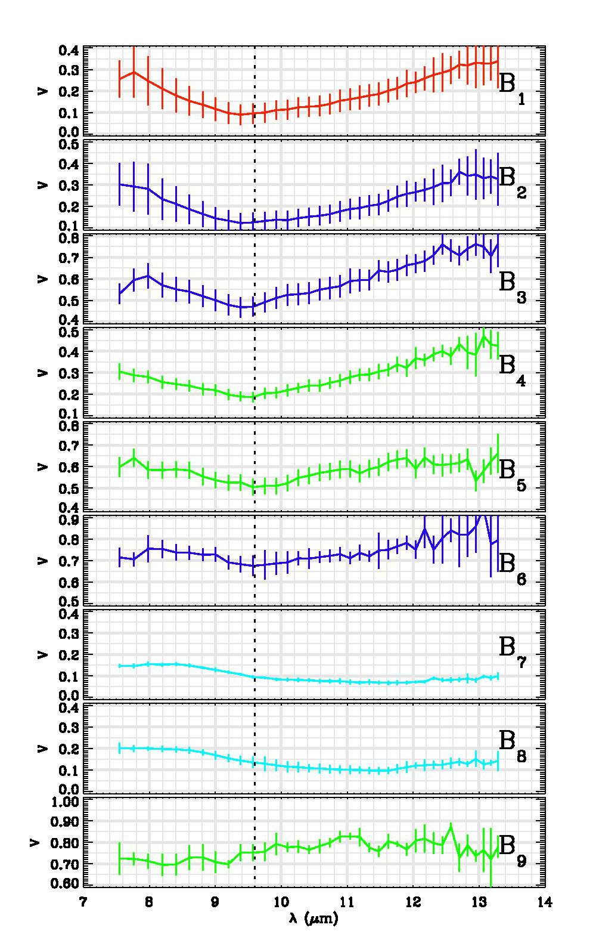
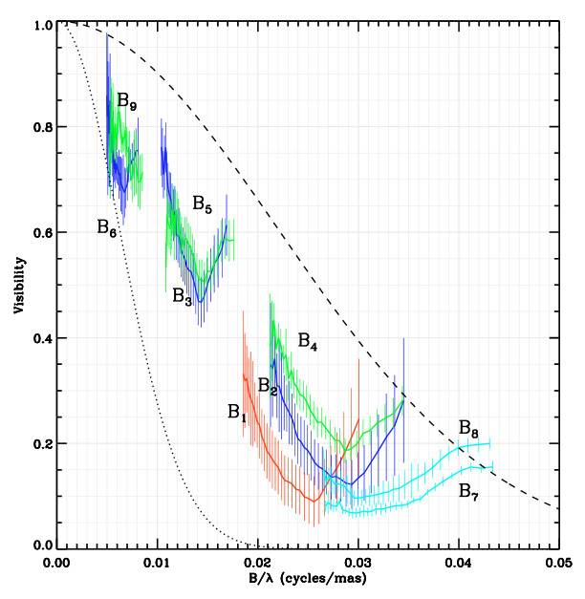
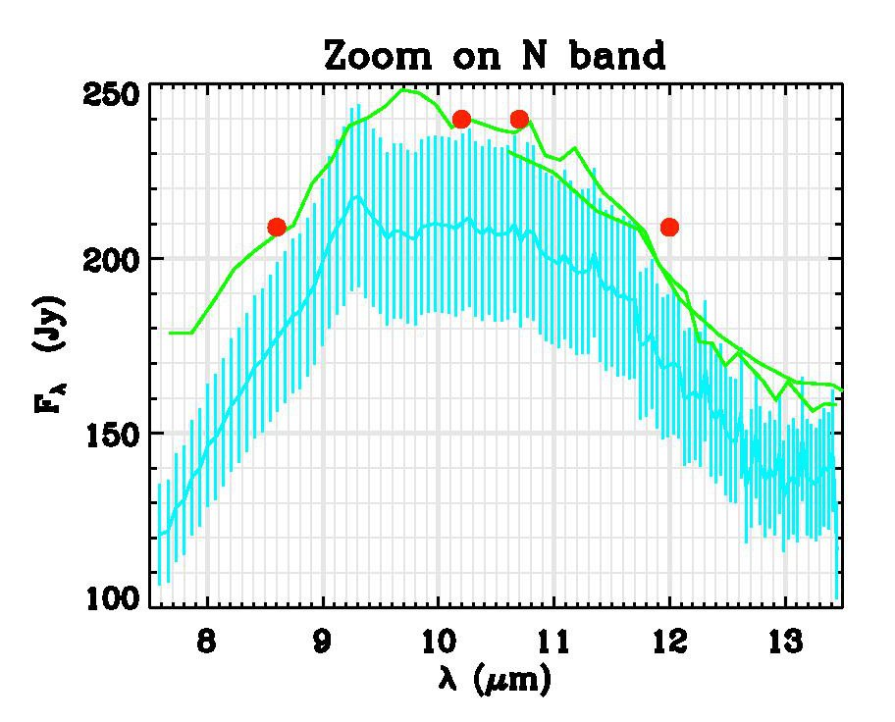
B[e] in the mid-infrared : data from HD62623
From Meilland+ 2010
b) B[e] in the mid-Infrared
2) Our interferometric journey around B[e] stars

Slide 25
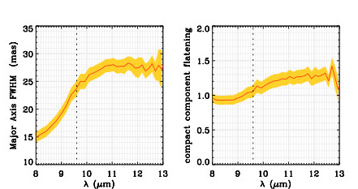
B[e] in the mid-infrared : modeling HD62623
From Meilland+ 2010
``Simple’’ wavelength-depend geometric model
What can be determined:
Extension => 15 to 25 mas
Orientation => Ʇ to the Polarization
Flatenning => lower limit on i=> 40°
Λ-dependent
Elliptical Gaussian
But no Physics !
b) B[e] in the mid-Infrared
2) Our interferometric journey around B[e] stars

Slide 26
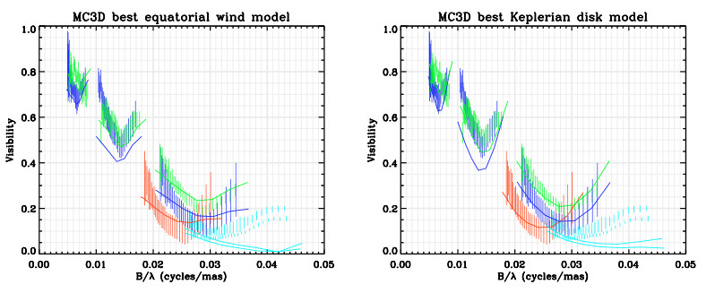
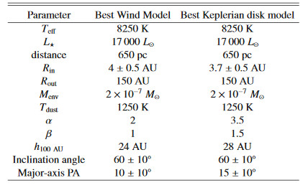
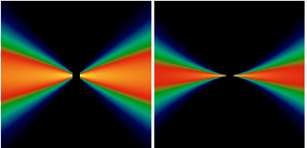
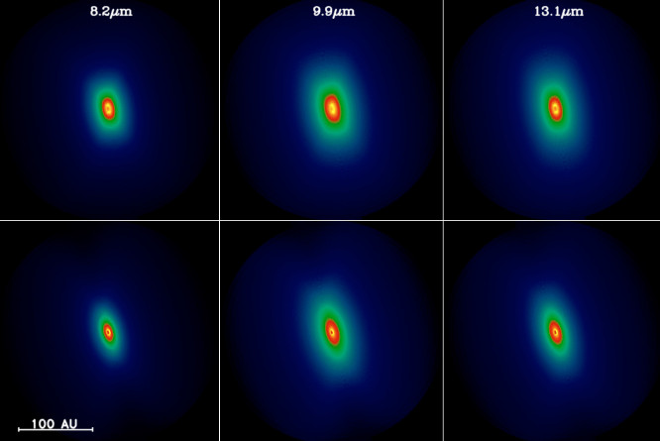
B[e] in the mid-infrared : modeling HD62623
From Meilland+ 2010
Radiative transfert modelling with MC3D (Wolf 2003)
Equatorial wind
Keplerian disk
b) B[e] in the mid-Infrared
2) Our interferometric journey around B[e] stars

Slide 27
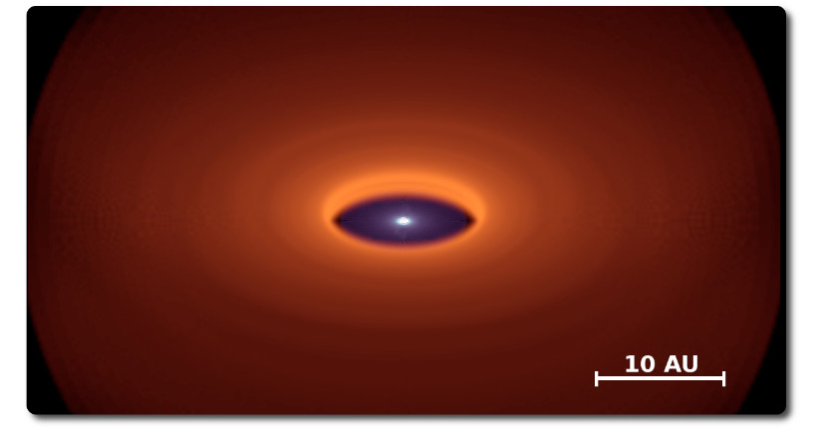
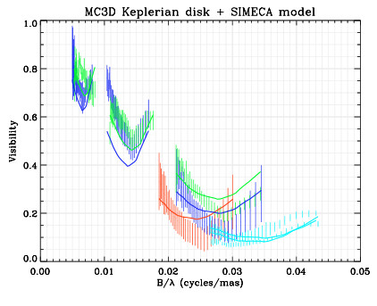
B[e] in the mid-infrared : modeling HD62623
From Meilland+ 2010
Radiative transfert modelling with MC3D (Wolf 2003) + SIMECA (Stee+ 1995)
E
We Add
4 10⁻⁷Mo
Of gas
N
b) B[e] in the mid-Infrared
2) Our interferometric journey around B[e] stars

Slide 28
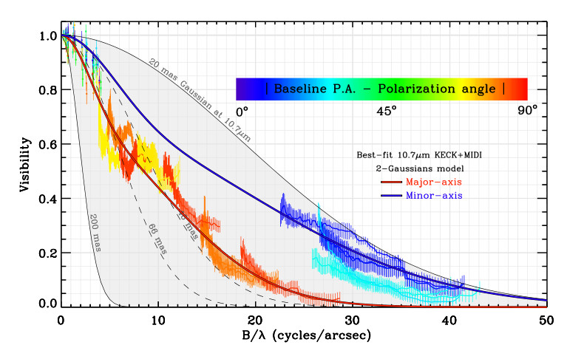
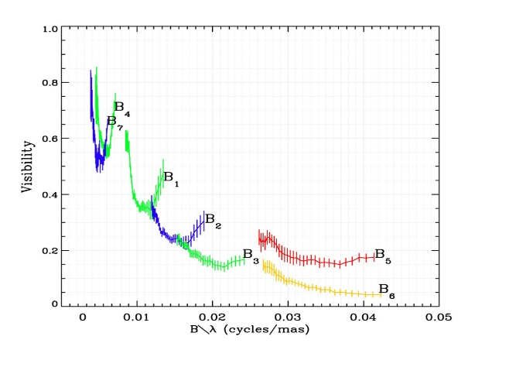




B[e] in the mid-infrared : Disks almost everywhere
HD50138
HD45677
HD87643 (Millour+ 2009)
Ʇ
Ʇ
Borges Fernandes+ 2011
CPD -52° 9243
CPD -57° 2874
Ʇ
\\
What is that?
Cidale+ 2012
GG Car (Domiciano de Souza 2015)
Hen 3-1191 (Lachaume+ 2007)
Domiciano de Souza+ 2007, 2011
b) B[e] in the mid-Infrared
2) Our interferometric journey around B[e] stars

Slide 29

The B[e] stars in the near-infrared continuum
Black Body :
N Band => 300 K
K Band => 1300 K
H Band => 1800 K
Hot Gas?
Dust disk inner rim
Star
c) B[e] stars in the near-IR continuum
2) Our interferometric journey around B[e] stars

Slide 30

The inner rim of dusty disks
Object | Paper | NIR size (AU) | Luminosity (Lo) | Comments
HD62623 | Millour+ 2011 | 3.7 | 17000 | Image & Ring
H50138 | Borges+ 2011 | 1.7 | 1000 | Gaussian
 | Ellerbroek+ 2015 | 1.7 |  | Gaussian
 | Kluska+ 2015 | 2.2 |  | Image & Gaussian
HD85567 | Wheelwright+ 2013 | 0.8±0.3 | 15000 | Ring
 | Vural+ 2014 | 0.7±0.3 |  | Ring-Temp
MWC300 | Wang+ 2012 | ~20 | 120000 | Ring + Binary
V921 Sco | Kreplin+ 2012 | 2.4±0.2 | 10000 | Ring-Temp
HD45677 | Monnier+ 2006 | 7.8 | 14000 | Skewed Ring
MWC84 | Thureau+ 2009 | 37.9±1.2 | ????? | Skewed Ring
HD327083 | Wheelwright+ 2012 | 5.1 | 10⁶ | Ring + Binary
CPD-57° 2874 | Domiciano de Souza+ 2007 | 8.5 | ????? | Gaussian
MWC300
HD45677
HD327083
HD50138
V921 Sco
HD62623
HD85567
Monnier+ 2005, Millan-Gabet+ 2006, Dullemond & Monnier 2010
c) B[e] stars in the near-IR continuum
2) Our interferometric journey around B[e] stars

Slide 31







The inner rim of dusty disks
Kluska+ 2014
VLTI/PIONIER
From model fitting…
B[e] ?
Renard+ 2010
VLTI/AMBER
Monnier+ 2006
IOTA/IONIC3
Benisty+ 2011
VLTI/AMBER
…to Imaging
c) B[e] stars in the near-IR continuum
2) Our interferometric journey around B[e] stars

Slide 32


The inner rim of dusty disks : HD62623
Reconstructed image
Image reconstruction
MIRA (Thiebault)
Fully compatible with
N band VLTI/MIDI
Meilland+ 2010
Star
Model
Gas
Dust inner rim
Geometric
model-fitting
Millour+ 2011
4 nights with VLTI/AMBER
K Band
108 V² + 36 CP
Interferometric Beam
From Millour+ 2011
c) B[e] stars in the near-IR continuum
2) Our interferometric journey around B[e] stars

Slide 33

HD62623 : spectro-interferometry
Continuum
Brγ with velocity fields
Image reconstruction
MIRA (Thiebault)
modified with self-cal
Brγ
Kinematic
model-fitting
Millour+ 2011
4 nights with VLTI/AMBER
K Band R=12000
108 V²(λ) + 36 CP(λ) + 108ϕ(λ)
From Millour+ 2011
d) B[e] stars in emission lines
2) Our interferometric journey around B[e] stars

Slide 34

HD62623 : Gas geometry and kinematics
Line-integrated flux image
Velocity fields image
Same flattening and orientation
as the dusty disk
No expansion (<10km.s⁻¹)
Compatible with Keplerian rotation
From Millour+ 2011
d) B[e] stars in emission lines
2) Our interferometric journey around B[e] stars

Slide 35


HD50138 : Gas geometry and kinematics in Brγ
Observations well fitted with a Keplerian disk
From Ellerbroek+ 2015
d) B[e] stars in emission lines
2) Our interferometric journey around B[e] stars

Slide 36



HD327083 : Geometry and Kinematics in Brγ
Increase of Visibility
Size smaller to
that in the Continuum
Assymetric phase variation
=> Assymetric or shifted disk
Wheelwright+ 2012
d) B[e] stars in emission lines
2) Our interferometric journey around B[e] stars

Slide 37
HD327083 : Geometry and Kinematics in CO
No Change in visibility in the CO lines
=> Size comparable to that in the Continuum
Star(s)
Brγ line
(Shifted)
CO lines
(close to inner rim)
Continuum
(Inner Rim of dusty disk)
Wheelwright+ 2012
d) B[e] stars in emission lines
2) Our interferometric journey around B[e] stars

Slide 38


HD327083 : Geometry and Kinematics in CO
Observations favour emission from
a ring in Keplerian motion
Star(s)
Brγ line
(Shifted)
CO lines
(close to inner rim)
Keplerian
Continuum
(Inner Rim of dusty disk)
Wheelwright+ 2012
d) B[e] stars in emission lines
2) Our interferometric journey around B[e] stars

Slide 39


HD85567 : Geometry and Kinematics in Brγ & CO
Brγ
Multiplexed CO lines flux
Compact disk in rotation
But hard to conclude
due to low SNR!
Multiplexed CO lines
photocenter offset
No clear signal
Wheelwright+ 2013
d) B[e] stars in emission lines
2) Our interferometric journey around B[e] stars

Slide 40




And what about visible observations of B[e]?
HD50138
MWC361
CHARA, mount Wilson, CA
Six 1 m telescopes
330m baselines
VEGA : R=6000 in Hα
θ_{min} = 0.2 mas
with mR<7.5
Ellerbroek+ 2015
Very low SNR ⬄Spectral binning
Benisty+ 2013
d) B[e] stars in emission lines
2) Our interferometric journey around B[e] stars

Slide 41

The binarity as seen by interferometers
δ Centauri (Meilland 2008+)
Oscillation amplitude (A)
⬄
Flux ratio (f)
f=A/2
Oscillation period (T)
⬄
Projected separation (s)
s=1/T
Detection limit due to spatial resolution
and interferometric field of view
0.2 mas < s < 150 mas
Detection limit due to flux ratio
f<100
e) The binarity of B[e] as seen by interferometry?
2) Our interferometric journey around B[e] stars

Slide 42
The binarity of B[e] as seen by interferometers
Name | Type of B[e] | Reference | Array/Instrument | Binarity
HD62623 | Supergiant/binary? | Meilland+ 2010 | VLTI/MIDI
 |  | Millour+ 2011 | VLTI/AMBER
HD50138 | Herbig or Unclassified | Borges Fernandes+ 2011 | VLTI/MIDI & VLTI/AMBER
 |  | Ellerbroek+ 2015 | VLTI/AMBER & CHARA/VEGA
 |  | Kluska+ 2016 | VLTI/PIONIER
HD87643 | Herbig or Unclassified? | Millour+ 2009 | VLTI/MIDI & VLTI/AMBER
CPD -57° 2874 | Supergiant | Domiciano de Souza+ 2007 | VLTI/MIDI & VLTI/AMBER
 |  | Domiciano de Souza+ 2011 | VLTI/MIDI
HD85567 | Herbig or Unclassified? | Wheelwright+ 2013 | VLTI/AMBER
 |  | Vural+ 2014 | VLTI/AMBER
MWC300 | Herbig or Unclassified? | Wang+ 2012 | VLTI/AMBER
Hen 3-1191 |  | Lachaume+ 2007 | VLTI/MIDI
V921 Sco | Unclassified | Kreplin+ 2012 | VLTI/AMBER
HD45677 | Herbig or Unclassified | Monnier+ 2006 | IOTA/IONIC
GG Car | Supergiant | Domiciano de Souza+ 2015 | VLTI/MIDI
MWC361 | Herbig | Benisty+ 2013 | CHARA/VEGA
MWC 84 | Supergiant/binary | Thureau+ 2009 | IOTA/IONIC & PTI
HD327083 | Supergiant/binary | Wheelwright+ 2012 | VLTI/AMBER
CPD -52° 9243 | Supergiant | Cidale+ 2012 | VLTI/MIDI
Companion detection
None
Indirect evidence
Weak direct
Strong direct
e) The binarity of B[e] as seen by interferometry?
2) Our interferometric journey around B[e] stars

Slide 43



HD87643 : A Binary B[e]
MIDI data
AMBER data
Millour+ 2009
e) The binarity of B[e] as seen by interferometry?
2) Our interferometric journey around B[e] stars

Slide 44



HD87643 : A Binary B[e]
Extraction of the SEDs of the three components
H Band
K Band
South
North
Circumbinary
N Band
Puzzling dusty object?
Cold dust with Silicate
B2V star + 1300K BB
Millour+ 2009
e) The binarity of B[e] as seen by interferometry?
2) Our interferometric journey around B[e] stars

Slide 45



HD327083 : A binary B[e]?
Possible binary detection
and
Compatible with Miroshnichenko+ 2003
Wheelwright+ 2015
e) The binarity of B[e] as seen by interferometry?
2) Our interferometric journey around B[e] stars

Slide 46

MWC300 : A binary B[e]?
Non-zero closure phase
⬄
Asymmetry
But not a clear binary signal
Wang+ 2012
e) The binarity of B[e] as seen by interferometry?
2) Our interferometric journey around B[e] stars

Slide 47
A little summary: B[e] as seen by interferometry
Visible
Mid-IR
Near-IR Continuum
Near-IR Lines
Dusty Disks
CO
Hα
Continuum
Size-lum similar to YSO
Brγ
Size increase
With λ
Higher opacity
In Silicate
Binarity?
Compact disk
Inner rims
< R_{in}
≈ R_{in}
Star?
Compact
gas
Forbidden lines
Radiative transfer
In dust
Disks
Skewedness
Diameter
Stratified?
Contribution
of the gas
Improved
accuracy
Keplerian rotation
No expansion detected
Radiative transfer
GAS + DUST
Improved
Accuracy & Sensitivity
More objects
Imaging capability
Longer baselines
Improved
Sensitivity
f) Conclusions
2) Our interferometric journey around B[e] stars

Slide 48


3) Interferometry : The next generation

Slide 49




Interferometry : The next generation at VLTI
PIONIER
2011
GRAVITY
2015
Still in commissioning
MATISSE
2017
All 4-telescopes combiners ( 6 V² + 3 CP)
H band
No Spectral resolution
mH<8
K band
Up to R = 4000
mK<6.5 (only for ATs)
Dual field (<4’’)
L,M, & N bands
Up to R = 4000
F_{12µm} > 1 Jy
Possible extension to J band
and spectral resolution
Potential « I-Shooter » mode with the 3 instruments
operating simultaneously ( 1.6- 13.5 µm)
+ possible Visible (R and I bands)
instrument for 3rd generation (after 2022)
3) Interferometry : The next generation

Slide 50

Interferometry : The next generation at CHARA
Installation of adaptive optics on the telescopes
B
V
R
H
K
VEGA (4T)
PAVO (2T)
VIS6T (6T) B? V R I
Mourard (Nice)
MIRC (6T)
MIRCx (6T) J? H
Monnier (Michigan)
CLIMB(3T)
FLUOR (2T)
Also « I-shooter » mode
0.6 – 2.5 µm
With a gain in limiting magnitude
MYSTIC (6T) K
Kraus (Exeter)
New generation of detectors
+
Fringe tracker?
3) Interferometry : The next generation

Slide 51

Thank you

